Slide 1
COVID-19 Mythbusting
Check our e-book out chapter by chapter!
https://igniteliberty.net/pineapples-on-mars-introduction/
Fairview Baptist Church
November 30th 6:30 pm
Dr. Amy B. Cerato
Dr. Eric M. Snyder
Notes:
Thank you to Mr. Blair, Mr. Fisher, and Bryan Armstrong with Ignite Liberty. Bryan has kindly offered to showcase our work on his website in chapter form as we prepare publication of the book. If you visit Ignite Liberty you can start reading the chapters under the “pineapple on mars” tab.

Slide 2
Disclosure
We are here today as independent researchers
We are not medical doctors, virologists, nurses, or primary care physicians
We are thankful for individual efforts of Oklahomans over the past 24 months
We encourage everyone to do their due diligence and check our research.
We are not perfect.

Slide 3
Discussion Topics
Stratified COVID-19 risk and Infection Fatality Rates (IFR)
Death Coding and Polymerase Chain Reaction (PCR)
Masking the Science and Disastrous Public Health Policies
Therapeutic Interventions and Censorship
The Strength of Natural Immunity
The Vaccine, Safety and Failure to Protect

Slide 4
Stratified COVID-19 risk and Infection Fatality Rates (IFR)

Slide 5
WORLD DEATH RATES
*2021 Trend based on current world population and deaths this year would result in the death percentage decreasing to 55.58 million or 0.70%
** This does not account for winter months approaching which could result in an increased death rate.
Notes:
Notes:
The rate of change in death rates % annually did not change during the first year of the pandemic. We are currently on pace for a decrease in the death rate percentage worldwide in 2021 as of November 1st we have a .63% death rate. We have a few months remaining of data and there is a concerning trend with the vaccine rates and fatality rates. The death rates are calculated: deaths/world populations = death %.

Slide 6
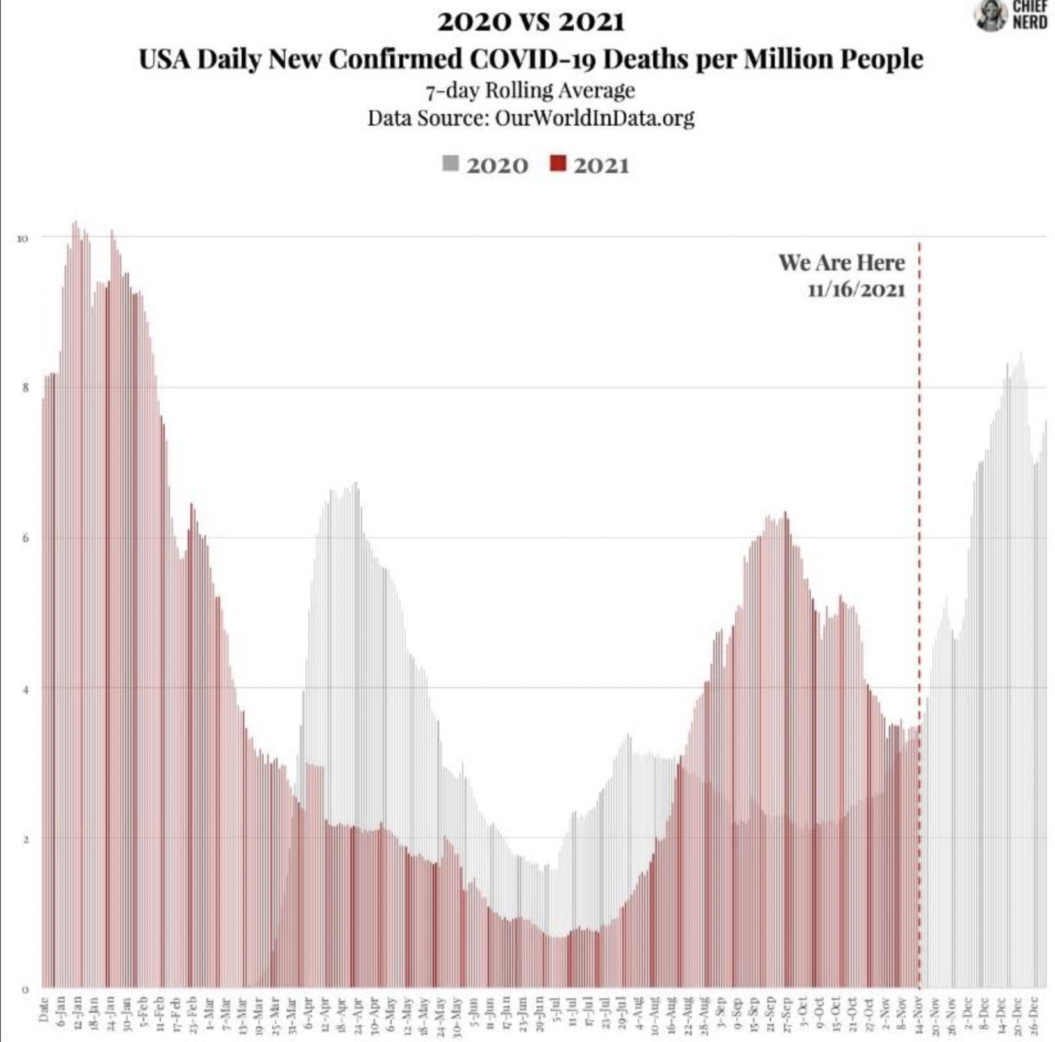

Slide 7
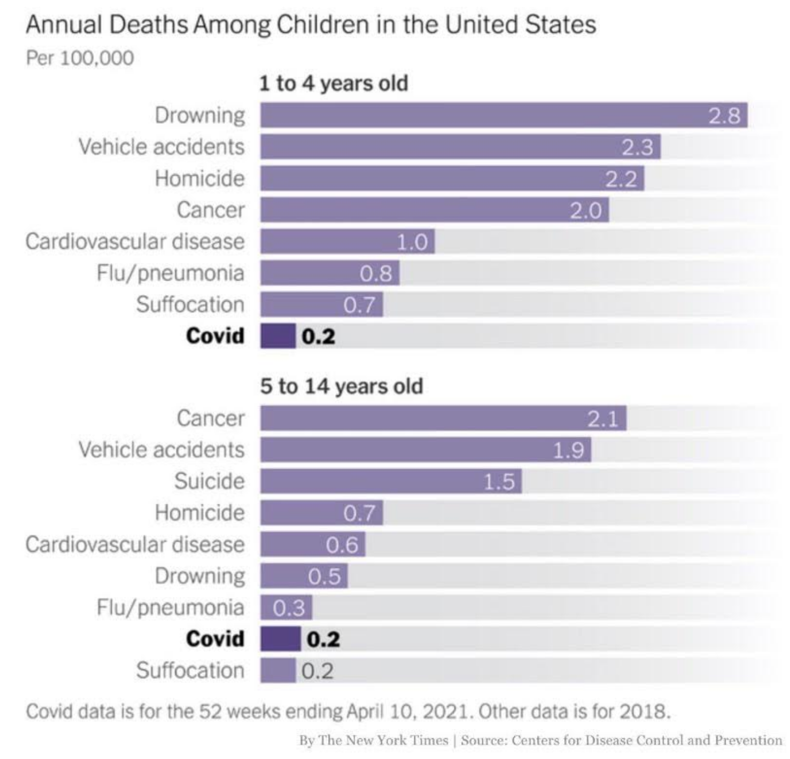
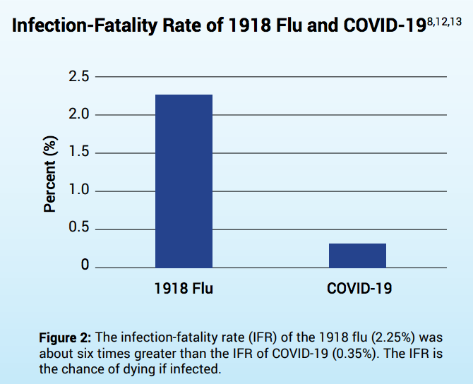
Fatality Infection Rate of Children
According to the CDC Published planning scenarios, the best estimated number of deaths (fatality infection rate) for children (Ages 0-17) would be 20 out of 1,000,000. This would calculate to a 99.9998% Infection Survivability Rate.
Physicians with Informed Consent ran IFR (1918 Flu vs Covid-19).
In total 587 children were listed in the database between the ages of 0-18 (January 4th, 2020 through October 8th, 2021) as dying “with” C19. Of the 587 listed deaths between ages 0-18, roughly 95% (557 Children) had other comorbidities listed on their death certificates. In other words, we cannot assume that Covid-19 was the "cause" of death more so than any of the other comorbidities.
If we take 5% of the 587- the result is 29 children dying “of” Covid-19. This is tragic, It is however important to provide perspective on what everyday living is really like as we interact with each other.
According to NEJM 2018 data on child Deaths, 4074 died in motor vehicle accidents, 3143 fire-arms related (e.g., suicide), 1,853 cancer, 1430 suffocation, 995 drowning, 982 drug overdose and poisoning,
In 2019 government data 1840 children died from abuse/neglect.
Notes:
In Oklahoma, the neglect and abuse report indicates a minimum of 40 children died from abuse and neglect in 2019: http://www.okdhs.org/OKDHS%20Publication%20Library/S19040.pdf. The State of Oklahoma has roughly 475,000 children ages 0-17 which would result in a prediction/estimation of 10 covid child deaths using CDC data.
Physicians with informed consent -- Compared the infection-fatality rate (IFR) of C19 with the 1918 Influenza outbreak and show that the 1918 flu had an IFR (chance of dying if infected) about 6 times greater than C19.
“Covid death” counts are artificially inflated. In some countries around the globe a “Covid death” can be defined as a “death by any cause within 28/30/60 days of a positive PCR test”.
Healthcare officials from Italy, Germany, the UK, US, Northern Ireland and others have all admitted to this practice:
Why do we continue to require young people to bear the burden of controlling a disease from which they face little to no risk? According to our own CDC database, there is a 99.95% chance of survival for people below the age of 50, and a 99.998% chance of survival for people below the age of 18. Source

Slide 8
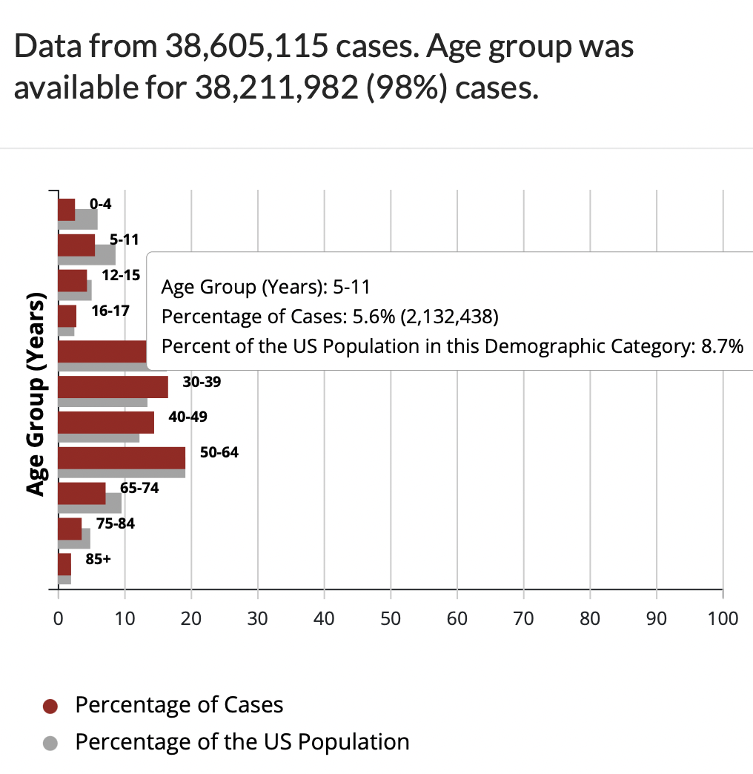
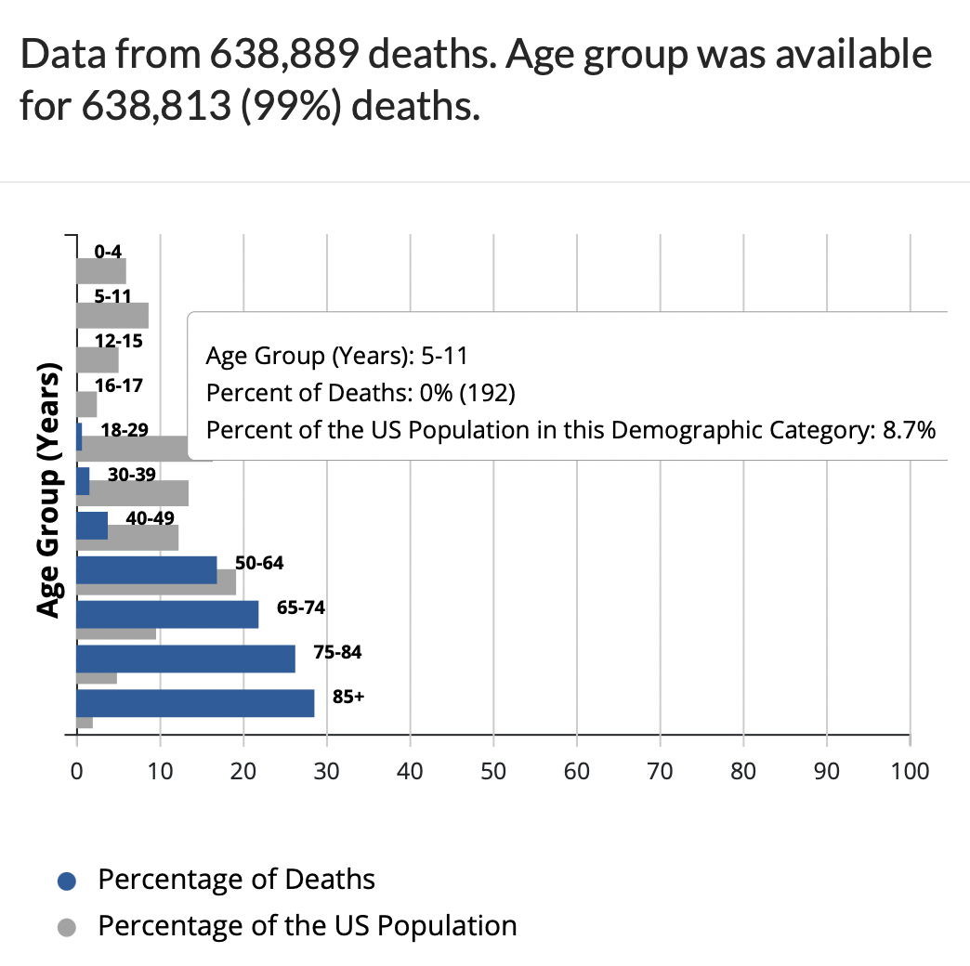
Children 5-11 Cases & Deaths (November 15th, 2021)
November 15th, 2021: 192 children ages 5-11 have died from “Covid-19 related illness” since the start of the pandemic.
With 2,132,438 cases and 192 deaths the 5-11 year old IFR = .000090%

Slide 9
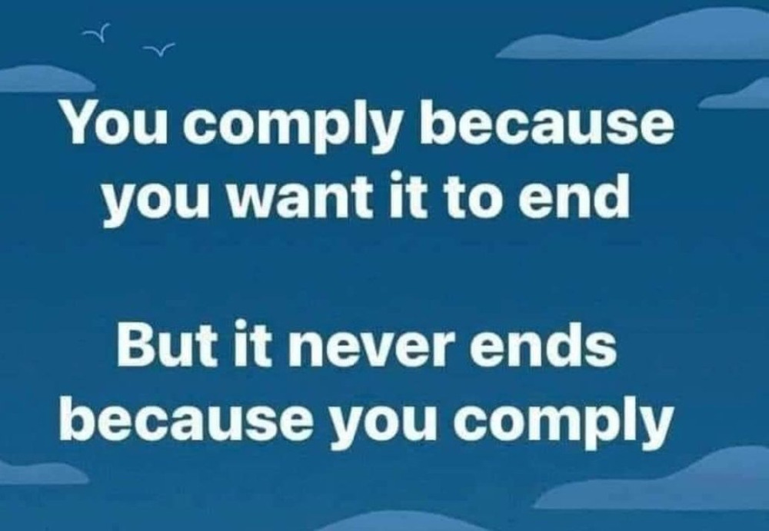
Death Coding and Polymerase Chain Reaction (PCR)

Slide 10
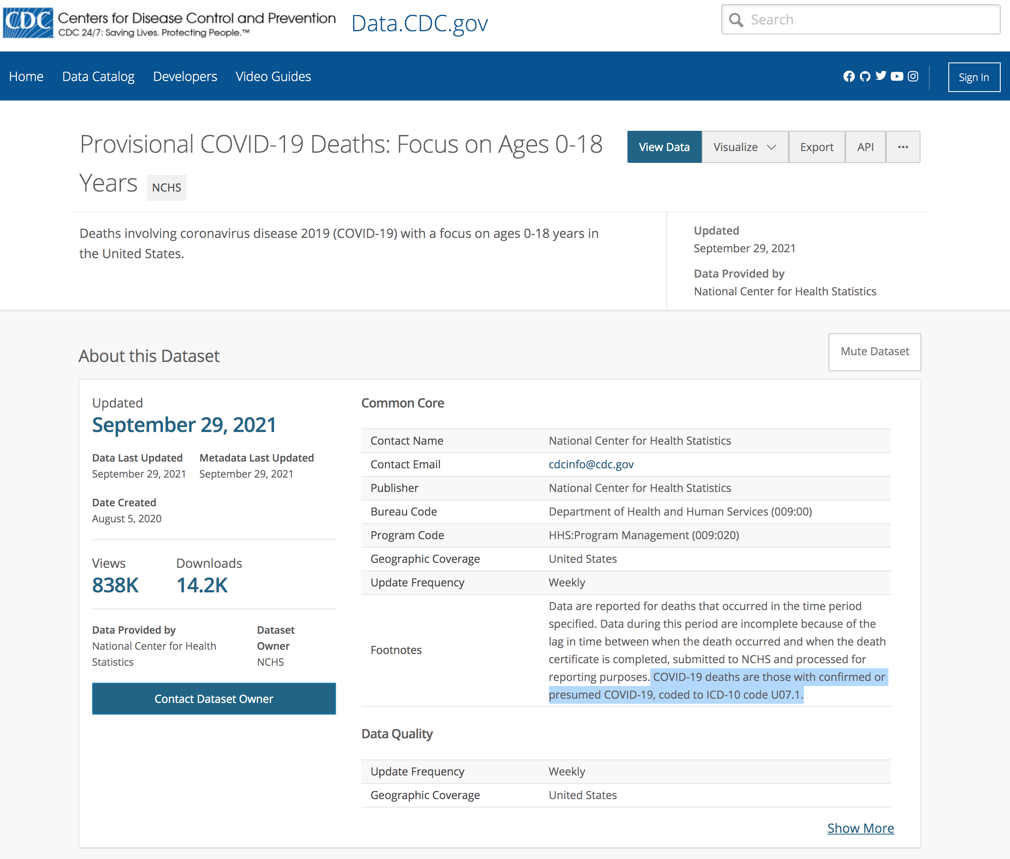
COVID Coding, Inflation, and Upcharges
How do we determine a COVID-19 death?
COVID-19 deaths are identified using an ICD–10 code. — The death is coded as U07.1. (see image)
“In cases where a definite diagnosis of COVID–19 cannot be made, but it is suspected or likely (e.g., the circumstances are compelling within a reasonable degree of certainty), it is acceptable to report COVID–19 on a death certificate as “probable” or “presumed.” In these instances, certifiers should use their best clinical judgement in determining if a COVID–19 infection was likely.”
Confirmed Laboratory test are not “normally” included with death certificates in the U.S. but for those with inconclusive or no testing available, the WHO requires U07.2 coding
California recently underwent a soft audit. Santa Clara and Alameda counties removed death certificates from death by car accidents, death by gunshot, accident, etc. They reduced their death reporting by 25%. (6/6/2021)
20% upcharge for COVID-19 label through center for Medicare and Medicaid services which is the population most impacted
Notes:
If we are using PCR tests as a confirmed lab diagnostic test, is this appropriate? The answer is NO.
Accurate fatality rates are important, and we get that from testing people for seroprevalence – how many people have evidence in their bloodstream of having had C19? You test for antibodies, and that is what the Dr. Jay Battacharya did in Santa Clara County, CA in April 2020 and found that more than 50,000 people had actually been infected and had the disease, while only 1,000 C19 cases had been identified through testing. (We will talk more about the need for continued antibody testing in the Convalescent Immunity section). This testing enormously important because it meant that the fatality rate was closer to 0.2% (#deaths/#people that had the disease); much less than what was reported using only the confirmed cases in the denominator. If the public had been told this accurate number, the fear factor would have dropped.
Both of those provisions for the 20% upcharge stems from the Coronavirus Aid, Relief, and Economic Security Act, or CARES Act.

Slide 11
PCR TESTING
Dr. Kary Mullis -Polymerase Chain Reaction
Noble Prize In Chemistry In 1993
The Test
Can Detect Small Genetic Sequences/Fragments Of Sars-Cov-2
“It Is Important To Note That Detecting Viral Material By PCR Does Not Indicate That The Virus Is Fully Intact And Infectious, (I.E. Able To Cause Infection In individuals or other People).
The Isolation Of Infectious Virus From Positive Individuals Requires Virus Culture Methods. These Methods Can Only Be Conducted In Laboratories With Specialist Containment Facilities And Are Time Consuming And Complex.
January 22, 2007 –
Gina Kolata Wrote In New York Times: “Faith In Quick Test Leads To Epidemic That Wasn’t.” The Article Articulates How Pcr Tests Can Be Disastrous.
Notes:
2007 - Dartmouth - Hitchcock Medical Center - Whooping cough outbreak- 1000 tested, 142 positives, Isolation and quarantining occurred, 8 weeks later testing revealed 0 cases. Dr. Trish Perl was interviewed and stated the following: “It’s a problem, its a real problem, My guess is what happened at Dartmouth is going to become more common.”
The PCR test “ is a process, and does not tell you that you are sick,” - Dr. Kary Mullis
Process-- Heats the DNA (separates into two strands)
Add Primers, (short pieces of DNA to connect to the target sections of the 2 strands)
The two strands look like a incomplete ladder---maybe three steps complete (then the left side of the ladder is gone)
Add polymerase which synthesizes and replicates the DNA, doubling the size, it then goes through another (cycle threshold)
The cycle threshold is selected by the technicians. A 40 cycle threshold would make about 1000 billion copies!
Great Video: PCR animation video - DNA Learning Center: https://www.youtube.com/watch?v=2KoLnIwoZKU&t=0s
Dr. Sam Bailey out of New Zealand does excellent work on Covid-19- Her website is: https://drsambailey.com/

Slide 12
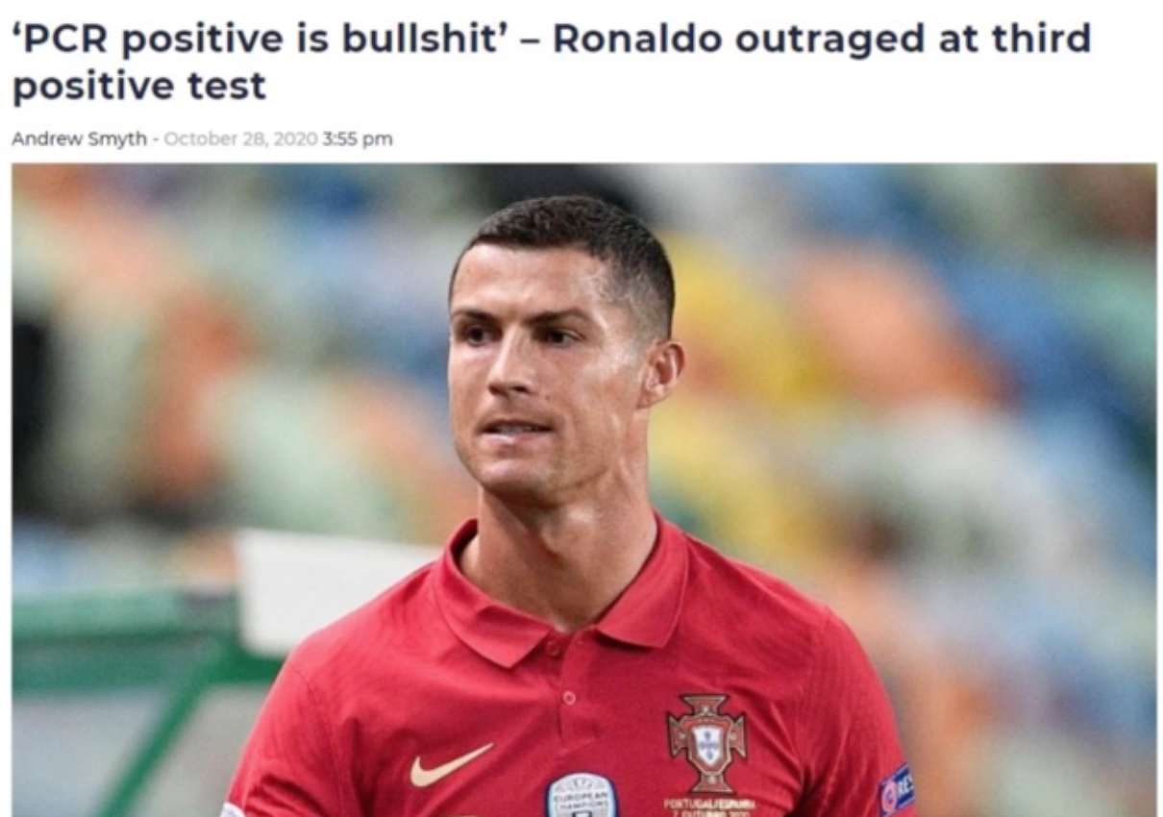
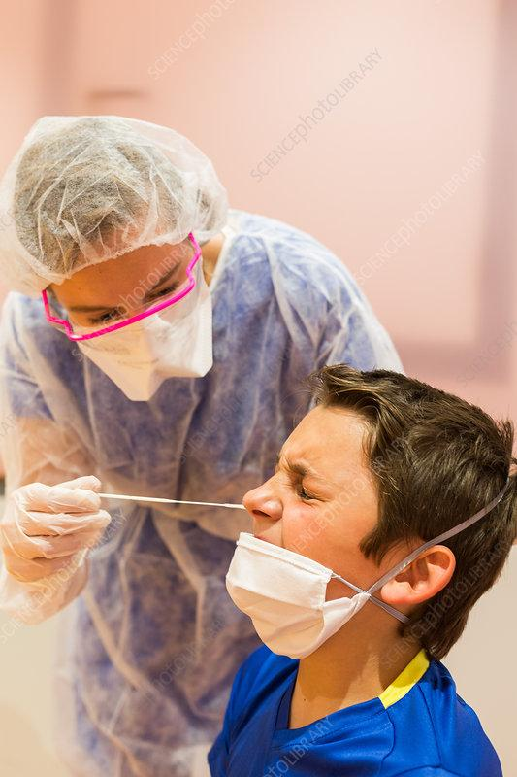
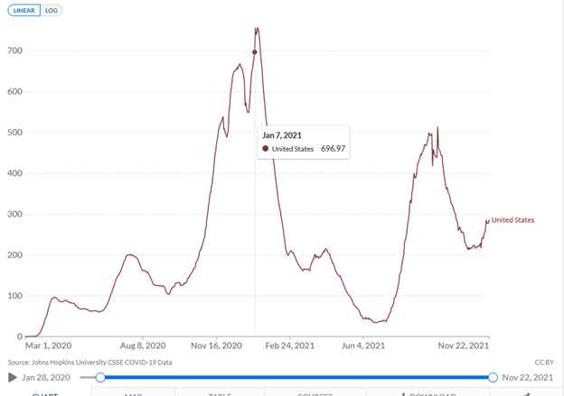
PCR TESTING
February 4, 2020 : The U.S. Food and Drug Administration (FDA) gave Emergency Use Authorization (EUA) for the RT-PCR test on February 4, 2020. Evidence in letter. An Emergency use authorization means that we have not medically approved the use through the FDA.
January 7th, 2021: SARS-CoV-2/Covid-19 Virus Pcr Ct Cutoff Values. On January 7th, Many states nationwide adjusted their threshold cycles from above 40 into the 30’s. Case rates dropped and were correlated with the release of vaccination.
Quest Diagnostics – A testing company was running PCR tests at 40 Ct.
Labcorp At 38. – A test company granted EUA to run PCR tests at 38 Ct.
Proof of adjustment to threshold cycles in Kansas – Until January 7th the state was ppinning the threshold cycles at 42 and reduced to 35.
John Hopkins University CSSE Covid-19 Data showing the change in PCR cycle threshold date and subsequent case rate history.
Notes:
These tests are not specific. We are covered with billions of microorganism that change rapidly. (Barbara McClintock another nobel prize winner discussed this) Most of the microorganisms have nothing to do with illness. PCR is an indirect test that detects fragments of organisms. A genetic sequence
This Covid-19 PCR was not calibrated to detect a specific new pathogen as PCR has never been purified.
It would be unsound medical practice to say that PCR test is used to Diagnose Covid-19.
What are the costs? How much is being spent in the state of Oklahoma?
From August 6th to September 14th in New Zealand - Testing and Lab costs were 74 million for 5 million people and 6 weeks of work.
We have never conducted a Double Blind Experimental Trial to date so we are using a test that actually has little connection to illness.
PCR Adjusting Threshold Cycles
Last summer (2020), the New York Times reported that CTs above 34 almost never detect live virus but most often, dead nucleotides that are not contagious. The Sentinel found that many private labs in Kansas used thresholds of 38 and 40, and another one in Lenexa potentially at 45. The state lab at the Kansas Department of Health initially used a 42 CT on its most commonly performed test; on January 7, they reduced it to 35.
As the above graph reveals, when the CT value was reduced, the caseload reduced and correlated with the roll-out of the vaccinations. The CDC then put in place a tiered system of diagnosis with guidance for determining those infected post-vaccination by April/May of 2021: "Clinical specimens for sequencing should have an RT-PCR Ct value ≤28.” By spinning at a CT of less than 28, the likelihood of a positive is reduced, whereas unvaccinated people will find it much easier to be diagnosed a “positive” PCR than vaccinated individuals.
It should be noted that saying a standard of 28 CT applied to the general testing regime would preclude as many as 90% of cases from being recorded.
This is a policy designed to continuously inflate one number, and systematically minimize the other.
Is this not an obvious and deliberate act of deception?
“As of May 1, 2021, CDC transitioned from monitoring all reported vaccine breakthrough cases to focus on identifying and investigating only hospitalized or fatal cases due to any cause. This shift will help maximize the quality of the data collected on cases of greatest clinical and public health importance. Previous case counts, which were last updated on April 26, 2021, are available for reference only and will not be updated moving forward.” https://www.cdc.gov/vaccines/covid-19/health-departments/breakthrough-cases.html
Just like that, being asymptomatic – or having only minor symptoms – will no longer count as a “Covid case” but only if you’ve been vaccinated.
https://www.zerohedge.com/covid-19/caught-red-handed-cdc-changes-test-thresholds-virtually-eliminate-new-covid-cases-among

Slide 13
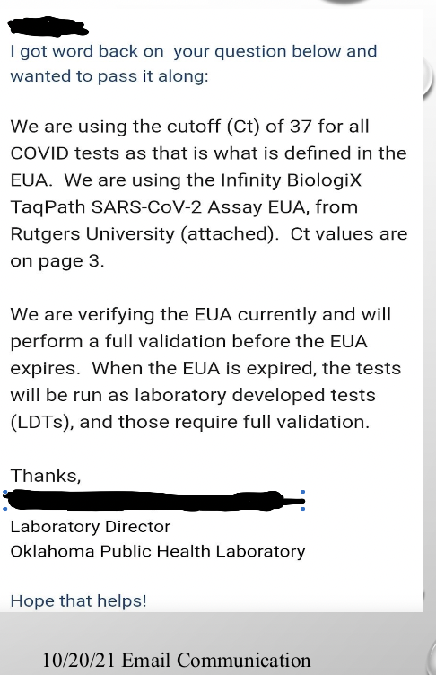
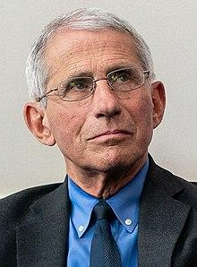
PCR TESTING
JULY 17TH, 2021
Dr. Fauci admits that “if you get a cycle threshold of 35 or more, the chances of it being replication-competent are minuscule,” Fauci said at roughly the four-minute mark of this video. ‘replication competent’ means particles capable of infecting cells and replicating to produce additional infectious particles.

Slide 14
PCR TESTING
JULY 21, 2021
CDC releases lab changes for testing. They will withdraw FDA, EUA to allow labs to select and implement alternatives.
See highlighted text
The PCR Ct value matters.
Notes:
Oxford Academic in September on the correlation between 3,790 positive PCR tests and 1,941 SARS-CoV-2 isolates. The researchers found that at a cycle threshold (ct) of 25, the test was 70 percent reliable, a figure that dropped to 20 percent at 30 cycles, and just three percent at 35 cycles. That meant 97 percent could have been false positives, yet they were used “in most laboratories in the USA and Europe
Surkova E, Nikolayevskyy V, Drobniewski F. False-positive COVID-19 results: hidden problems and costs. Lancet Respir Med. 2020 Dec;8(12):1167-1168. doi: 10.1016/S2213-2600(20)30453-7. Epub 2020 Sep 29. PMID: 33007240; PMCID: PMC7524437.
Braunstein GD, Schwartz L, Hymel P, Fielding J. False Positive Results With SARS-CoV-2 RT-PCR Tests and How to Evaluate a RT-PCR-Positive Test for the Possibility of a False Positive Result. J Occup Environ Med. 2021;63(3):e159-e162. doi:10.1097/JOM.0000000000002138

Slide 15
Masking the Science and Disastrous Public Health Policies

Slide 16
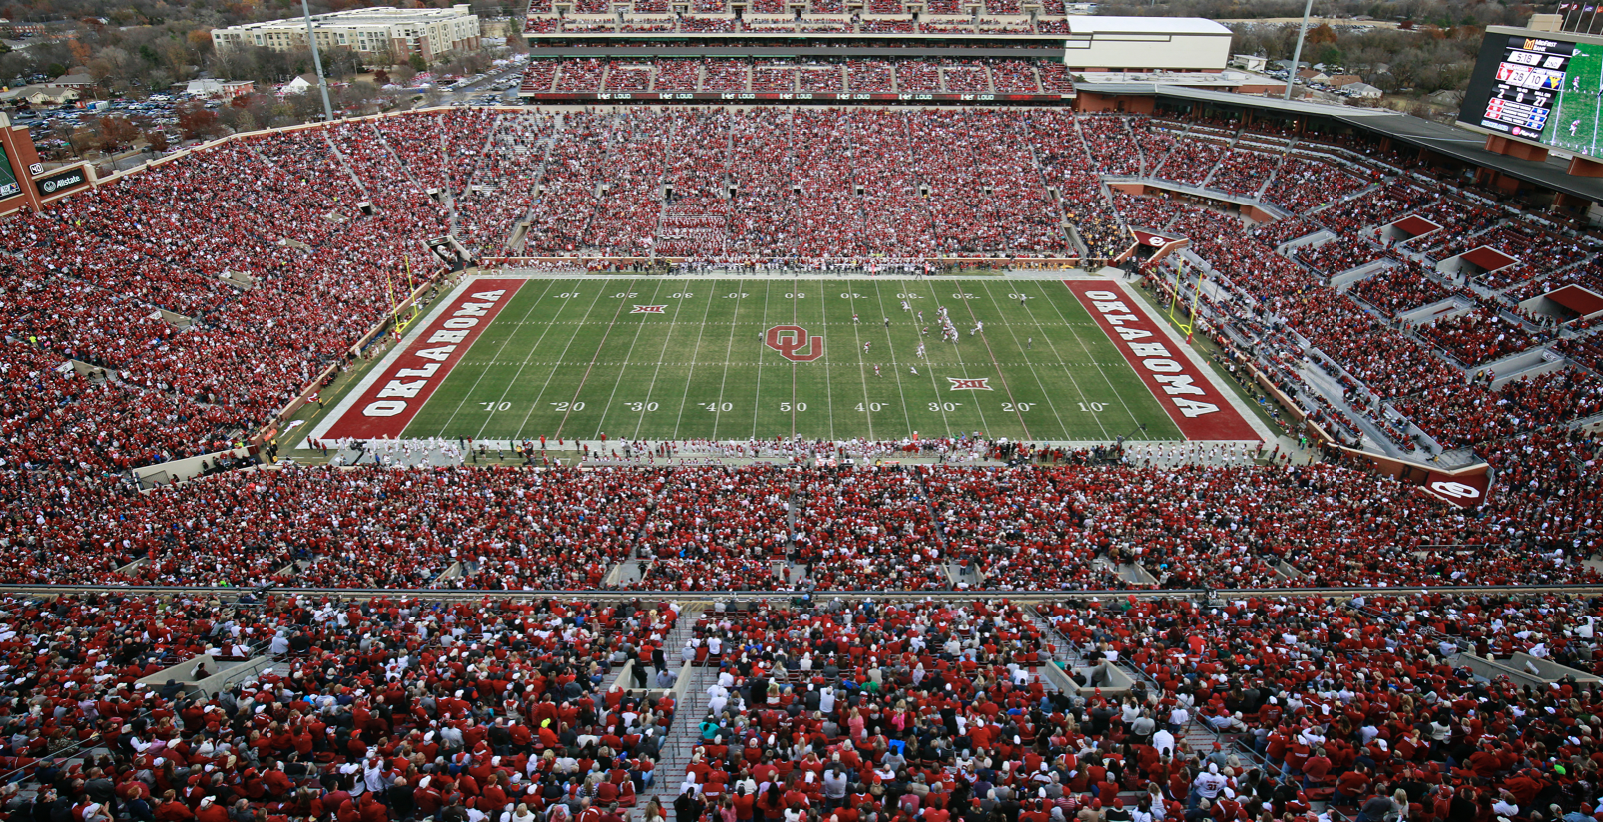
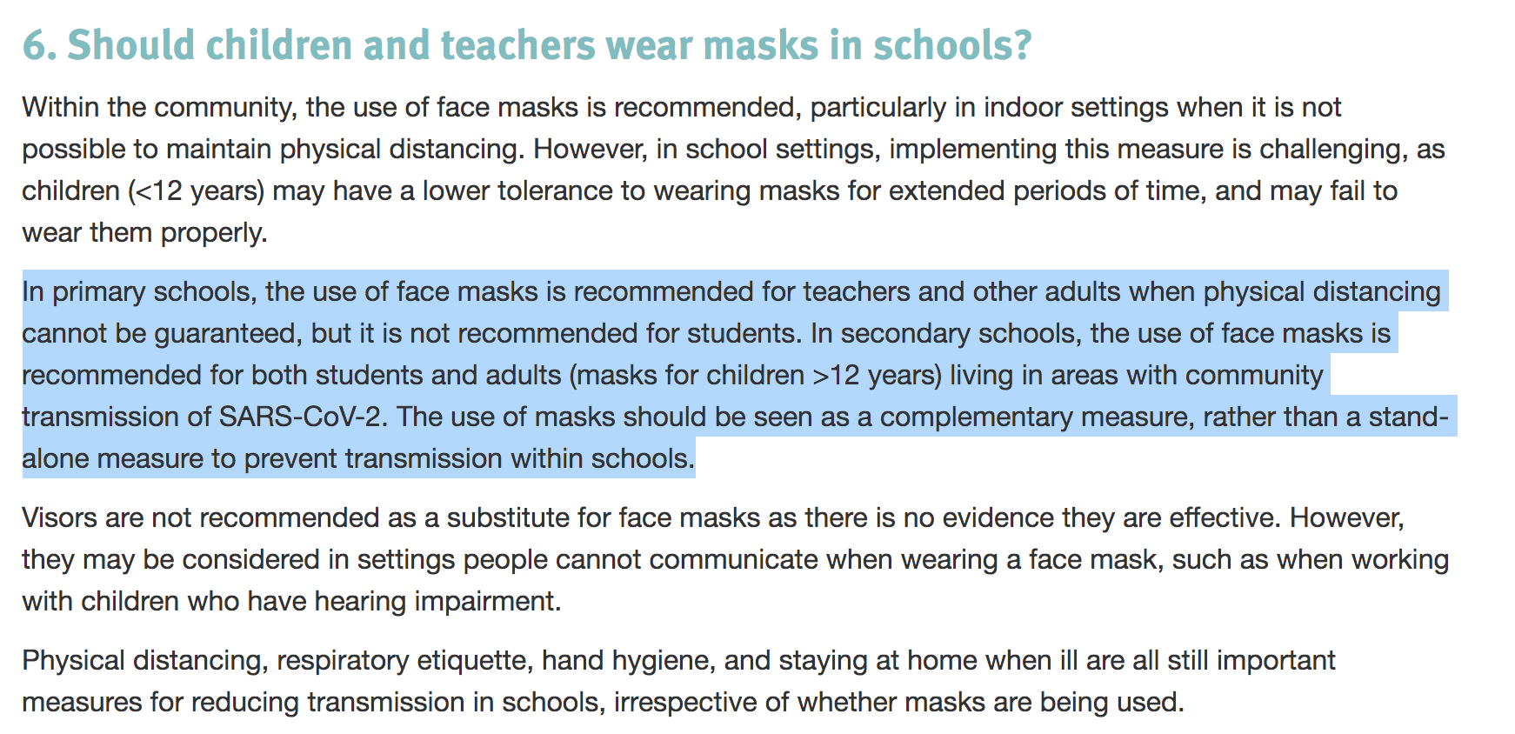
MASKS
A May 2020 meta-study on pandemic influenza published by the US CDC found that face masks had no effect, neither as personal protective equipment nor as a source control. (14 RCT’s)
An analysis from Brown University, found that "In all analyses, rates are similar for staff in districts with mask mandates for both students and staff versus those with staff-only mandates. Further, we do not see a correlation between mask mandates and Covid-19 rates among students in either adjusted or unadjusted analysis -(12 million participants)
As New York magazine noted, many European nations have exempted students from mask mandates.
“These countries, along with the World Health Organization, whose child-masking guidance differs substantially from the CDC’s recommendations, have explicitly recognized that the decision to mask students carries with it potential academic and social harms for children and may lack a clear benefit.”
We have research on 48+ peer reviewed studies on mask use for review and included in the notes
European Center for Disease Prevention and Control, September 8th, 2021
Notes:
Wilfried Kellogg (1919) efficacy of mask wearing during the Spanish Flu. “Unhygienic influence when extended to the entire working day of the individual”
California STate Board of Health issued a regulation requiring the wearing of face masks by those in contact with known cases. Any health officer could arrest any person with a cold who was found going about in public unmasked. Boston, Buffalo, San Francisco and Washington
Confirmed Kellogg with International Journal of Environmental Res. Public Health (2021) article which found oxygen drop, and fatigue, respiratory impairment and oxygen drop, N95 masks and Co2 rise, N95 Masks and O2 drop, N95 masks and headaches, respiratory impairment and temperature rise, temperature rise and moisture under the mask.
The Brown University Study included Florida, Massachusetts, and New York students/staff from 2020-2021.
Plain cloth covering has near zero efficiency at filtering .3 um size particles or below-- scientific evidence shows us Covid-19 particles are .125um.
https://academic.oup.com/annweh/article/54/7/789/202744; https://www.cidrap.umn.edu/news-perspective/2020/04/commentary-masks-all-covid-19-not-based-sound-data; https://academic.oup.com/annweh/article/54/7/789/202744
October 5, 2021: Florida Study: Data from Florida schools both with and without mask mandates shows that masks on kids make no difference inside schools when it comes to covid cases. COVID positivity rates declined at a rate of 65 percent for unmasked districts, as compared to 67 percent for masked. Put simply, the data for this school year shows no benefit to forced masking in pediatric age groups in terms of either case rate or positivity rate.
An Additional 30 Studies on Mask Efficacy
https://www.medrxiv.org/content/10.1101/2021.05.18.21257385v1.full-text
https://swprs.org/face-masks-evidence/
https://pubmed.ncbi.nlm.nih.gov/29395560/
https://pubmed.ncbi.nlm.nih.gov/32590322/
https://pubmed.ncbi.nlm.nih.gov/15340662/
https://pubmed.ncbi.nlm.nih.gov/26579222/
https://pubmed.ncbi.nlm.nih.gov/31159777/
https://www.ncbi.nlm.nih.gov/pmc/articles/PMC4420971/
https://www.medrxiv.org/content/10.1101/2020.04.01.20049528v1
https://www.medrxiv.org/content/10.1101/2020.03.30.20047217v2
https://www.nejm.org/doi/full/10.1056/NEJMp2006372
https://jamanetwork.com/journals/jama/fullarticle/2749214
https://www.cmaj.ca/content/188/8/567
https://www.ncbi.nlm.nih.gov/pmc/articles/PMC5779801/
https://pubmed.ncbi.nlm.nih.gov/19216002/
https://www.ncbi.nlm.nih.gov/pmc/articles/PMC4420971/
https://academic.oup.com/cid/article/65/11/1934/4068747
https://www.jstage.jst.go.jp/article/bio/23/2/23_61/_pdf/-char/en
https://link.springer.com/article/10.1007/BF01658736
https://www.journalofhospitalinfection.com/article/0195-6701(91)90148-2/pdf90148-2/pdf)
https://www.ncbi.nlm.nih.gov/pmc/articles/PMC2493952/pdf/annrcse01509-0009.pdf
https://web.archive.org/web/20200717141836/https://www.cidrap.umn.edu/news-perspective/2020/04/commentary-masks-all-covid-19-not-based-sound-data
https://www.nap.edu/catalog/25776/rapid-expert-consultation-on-the-effectiveness-of-fabric-masks-for-the-covid-19-pandemic-april-8-2020
https://www.nap.edu/read/25776/chapter/1#6
https://wwwnc.cdc.gov/eid/article/26/5/19-0994_article
https://academic.oup.com/annweh/article/54/7/789/202744
https://www.ncbi.nlm.nih.gov/pmc/articles/PMC6599448/
https://www.acpjournals.org/doi/10.7326/M20-1342
https://link.springer.com/article/10.1007/s00392-020-01704-y
https://clinmedjournals.org/articles/jide/journal-of-infectious-diseases-and-epidemiology-jide-6-130.php?jid=jide
https://www.sciencedirect.com/science/article/abs/pii/S1130147308702355

Slide 17
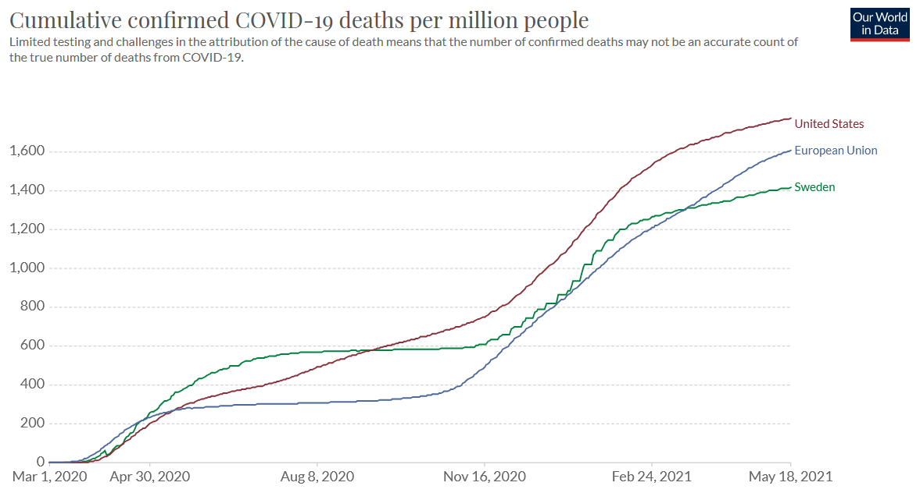
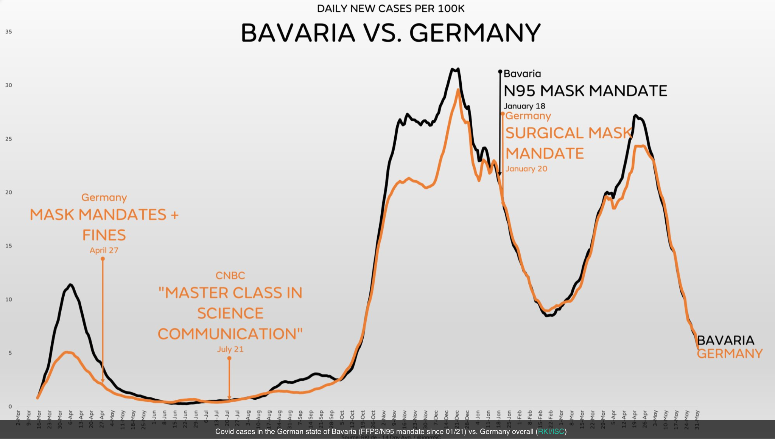
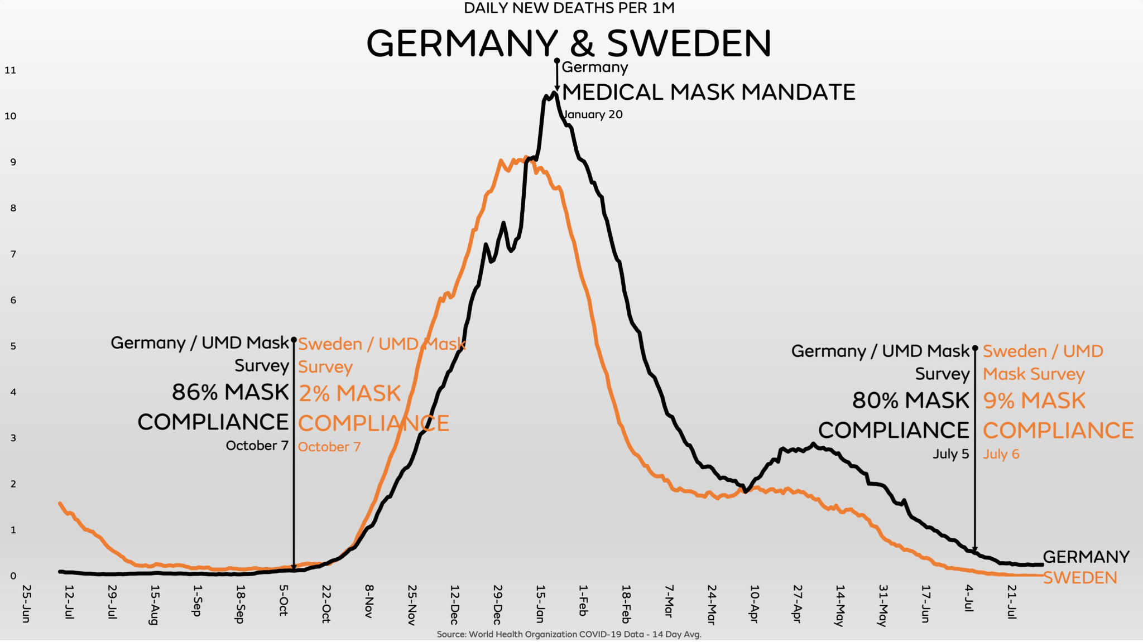
THE ILLUSION OF CONTROL
Notes:
The chart on the top show Covid case per million in North and South Dakota. North Dakota implemented mask mandates and business restrictions whereas South Dakota did not implement any Covid restrictions and you can see that the trend lines are similar. The 2nd chart shows Covid deaths in Sweden, without lockdowns, masks and primary school closures and one of the lowest ICU capacities in Europe , they are lower than the average deaths per million people in both the EU and the US. In other words, the many measures proposed by experts have been largely ineffective medically, but highly destructive socially and economically.
The ONLY effective intervention to reduce severe disease and deaths has been ignored or blocked by most Western health authorities, which is evidence based early and prophylactic treatment.

Slide 18
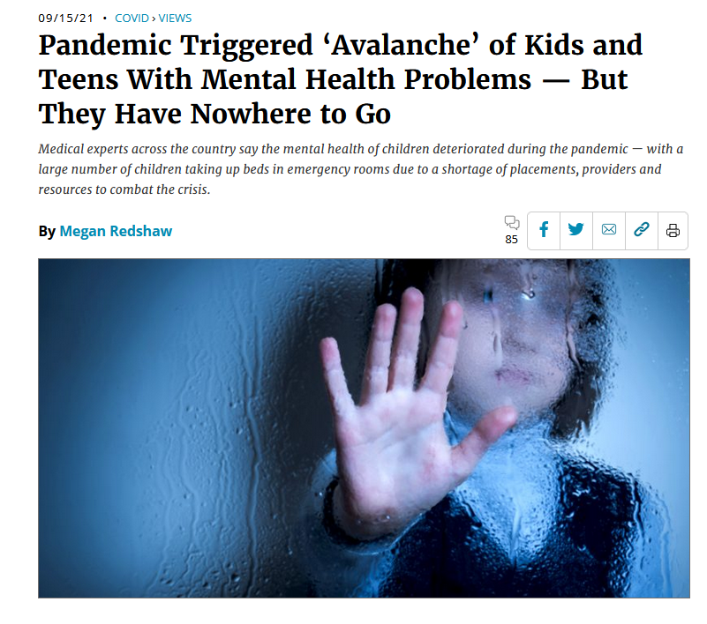
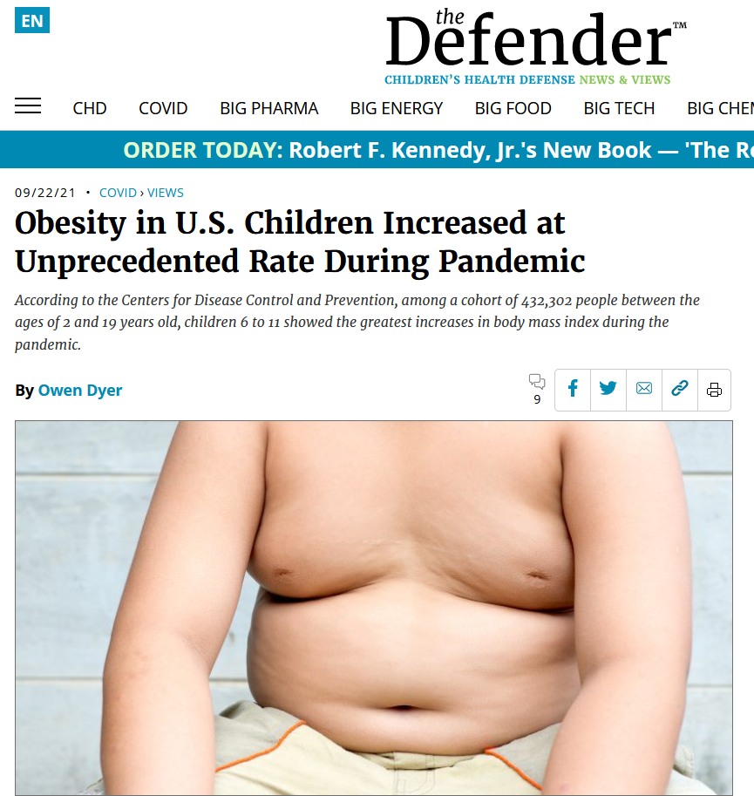
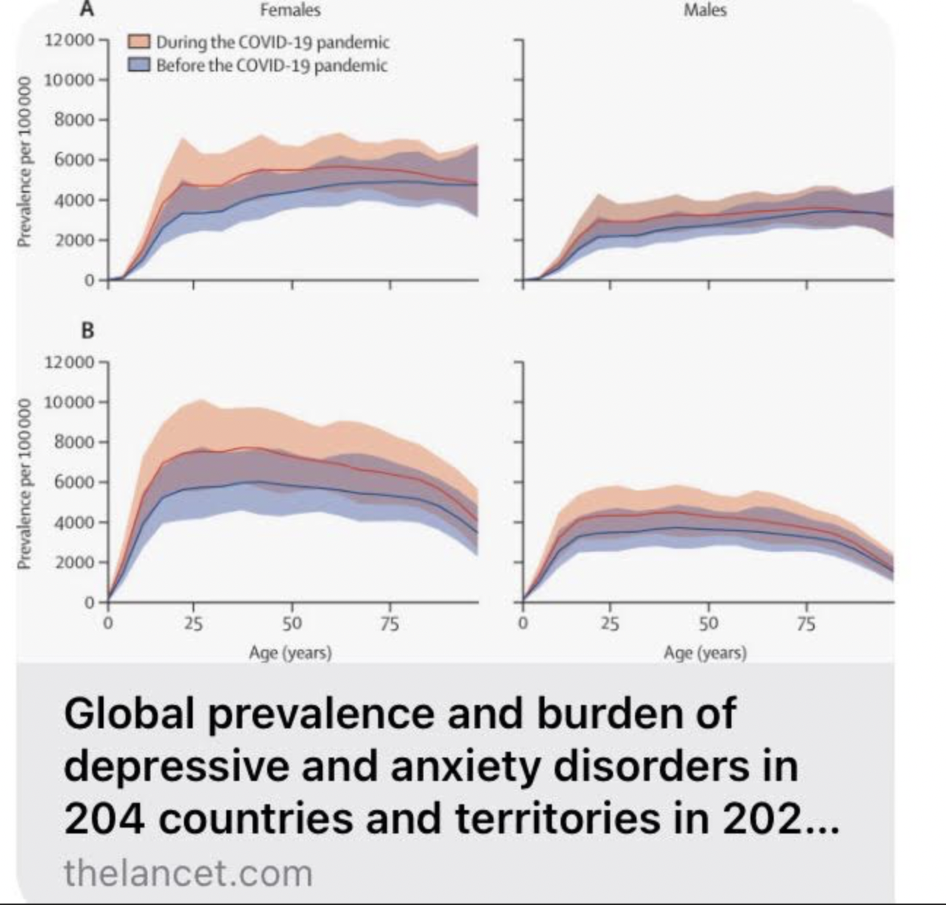
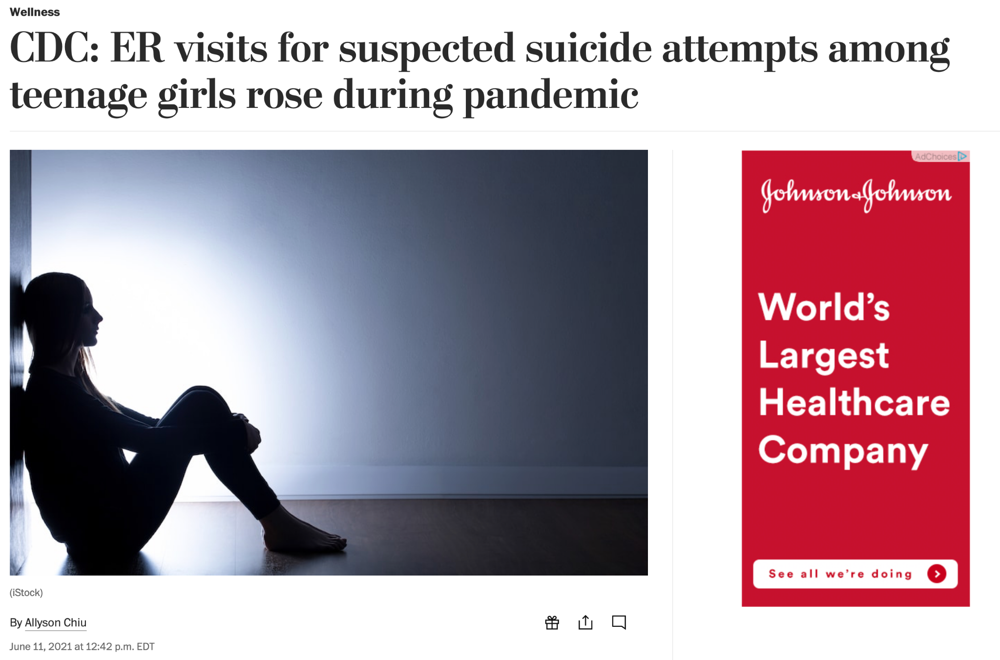
Notes:
Image 1: The Centers for Disease Control and Prevention found emergency department visits for suspected suicide attempts during February and March of 2021 were more than 50% higher for teen girls compared to 2019, and more than 4% higher for boys.
“In the last year, there’s been an avalanche of very severely depressed and anxious children and adolescents,” said San Francisco child psychiatrist Michelle Guchereau. It’s “heartbreaking” and “overwhelming” to have to turn some away, she said.
From April to October 2020, U.S. hospitals saw a 31% increase in 12- to 17-year-old kids seeking help for their mental health, and a 24% increase for kids ages 5 to 11.
Image 2: Among a cohort of 432 302 people aged 2-19 years, the rate of body mass index (BMI) increase roughly doubled during the pandemic compared with the period preceding it. The greatest increases were seen in children aged 6-11 and in those already overweight before the pandemic.
The national weight gain will surprise few pediatricians, who have been warning since the pandemic began of the likely effects of reduced physical activity and increased screen time. But the rate of change is striking. The monthly rate of BMI increase nearly doubled, to 1.93 times its pre-pandemic rate.
The proportion of U.S. children who are obese was rising by 0.07% a month before the pandemic, but by 0.37% a month — five times faster — after the virus appeared.
An estimated 22% of U.S. children and teens were obese last August, up from 19% a year earlier. The data shows a “profound increase in weight gain for kids” that is “substantial and alarming,” Alyson Goodman, one of the study’s authors, told the Associated Press.
Before the pandemic, children who were a healthy weight were gaining an average of 1.55 (3.4 lbs) kg a year. That rose to 2.45 kg (5.4 lbs) during the pandemic. In those who were already moderately obese, weight gain rose from 2.95 kg (6.5lbs) a year to 5.45 kg (12 lbs) after the pandemic began. In the severely obese, average annual weight gain went from 4 kg (8.8 lbs) to 6.6 kg (14.55 lbs).
Adults Impact of Lancet Study
The Lancet study published on October 8th, 2021 found that rates of depression have increased by 53.2 million individuals within the nations included in the study. This resulted in a 27% increase in depression. As far as anxiety and additional 73.2 million cases resulted in 25% increase.
Basic Psychology---Stress, Anxiety, Depression, Isolation, Suicide.

Slide 19
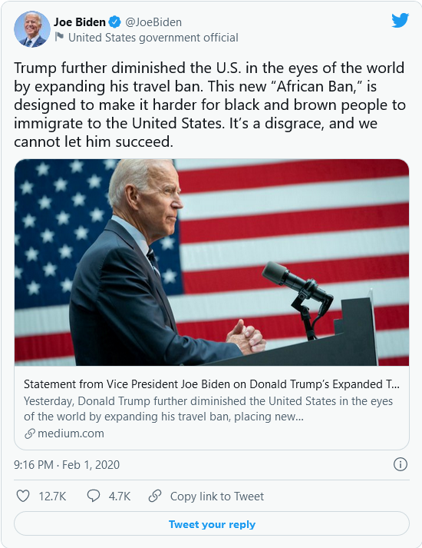
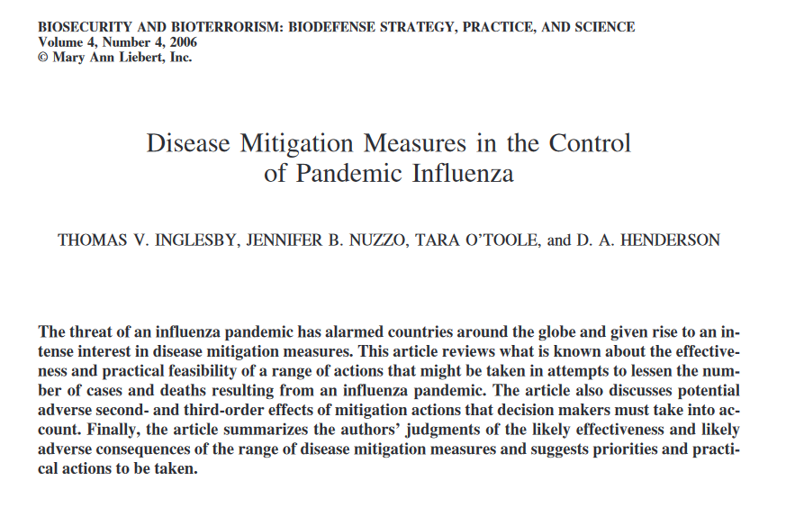
How to mitigate a pandemic - thoughts from 2006
Notes:
https://citeseerx.ist.psu.edu/viewdoc/download?doi=10.1.1.552.1109&rep=rep1&type=pdf

Slide 20
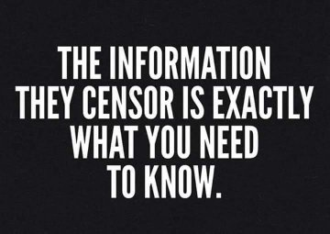
Therapeutic Interventions and Censorship

Slide 21
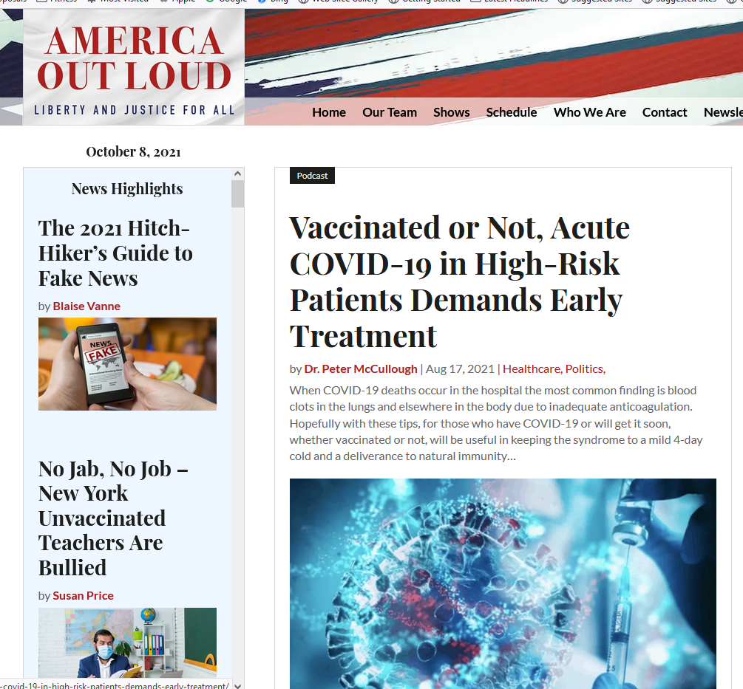
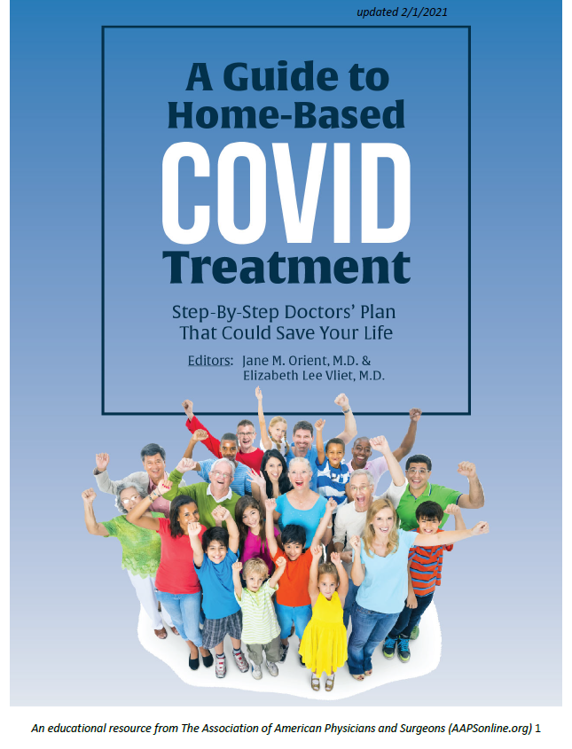
https://www.americaoutloud.com/
Notes:
Mortality is a function of treatment. Treatments markedly reduce mortality. It isn’t the virus that dictates mortality, it is how we respond to it. and fortunately the early treatment works.
Early home treatment is the only thing that makes sense. We can never differentiate between an unvaccinated and vaccinated for treatment. that would be medical apartheid. Medical tyranny. We treat alcoholics, we treat car accident victims, we treat drug overdoses, we treat gang members with gunshot wounds, with compassion. Why aren’t we treating the unvaccinated with compassion? Why is the medical establishment denying health care to people on the basis of their vaccination status? They made an intelligent choice to not be vaccinated due to the risks we’ve talked about, and we need to treat everyone.
The doctors should be fulfilling their hippocratic oath and treating Covid with drugs that work. It is a doctor’s oath to help all people compassionately. It is immoral, unethical and illegal and I hope there is a price to pay for all the medical establishment who let their patients die with inadequate treatment.

Slide 22
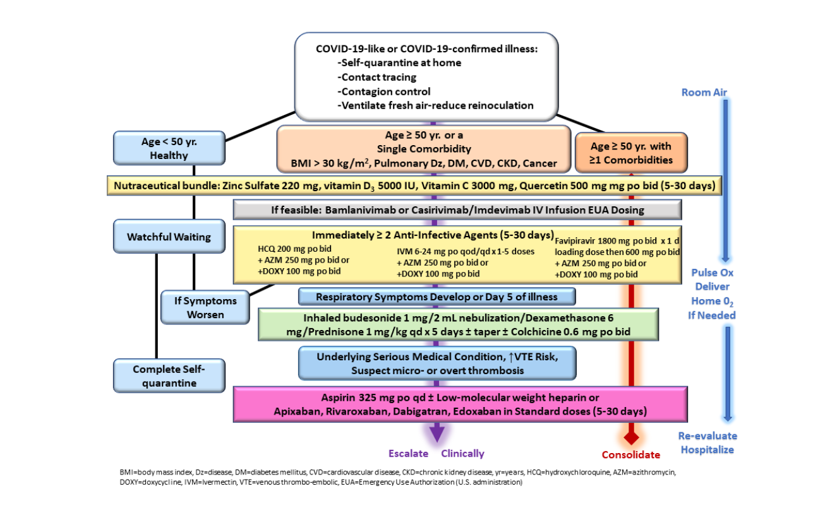
Full Text
Notes:
Early sequential multidrug therapy utilizing risk stratification and available nutraceuticals, appropriately prescribed approved drugs, and U.S. Food and Drug Administration Emergency Use Authorization Agents. January 7, 2021

Slide 23
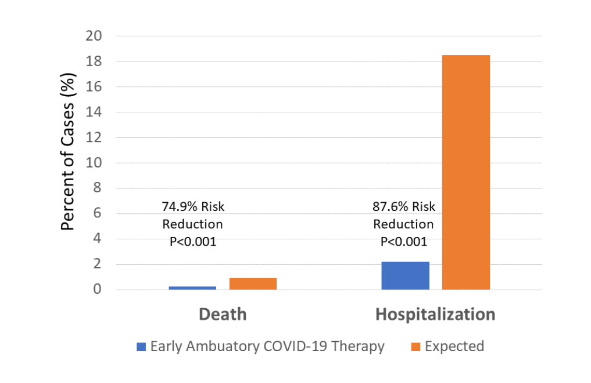
Full Text
Notes:
“In conclusion, our data suggest more than three quarters of hospitalizations and death are avoidable with early ambulatory treatment by primary care teams. Supported by our durable results, we believe early multidrug, ambulatory treatment should be offered as an emergency measure in acutely ill, high-risk COVID-19 as a strategy to reduce hospitalization and death. In our opinion, ambulatory treatment is preferable to hospitalization for salvage therapies that are applied too late and associated with complications and in-hospital death.”

Slide 24
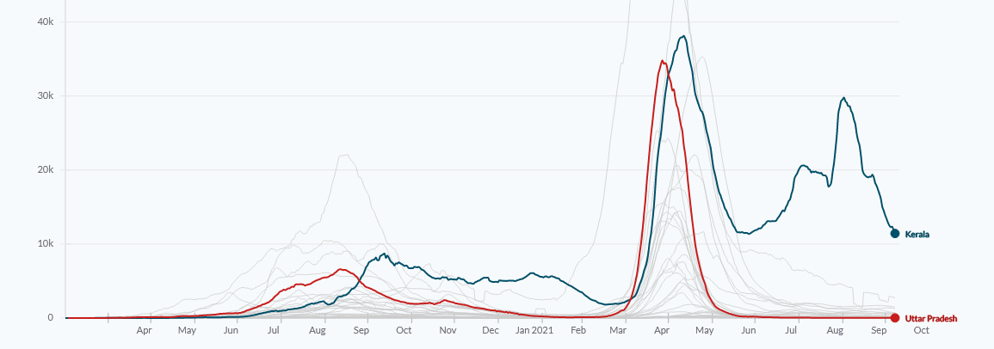
PROPHYLACTIC AND EARLY TREATMENT WORKS!
Uttar Pradesh (241 million people and 25% vaccinated) – Low COVID deaths and infections because of preventative and early treatment with Ivermectin and Hydroxychloroquine
Kerala (34 million People and 70% above 45 y.o. Vaccinated) – Increasing Caseload due to NOT implementing Ivermectin early and then removing completely from protocol
https://viz.newsclick.in/covid19-cases-graphs-maps-india-world
Kerala
Uttar Pradesh
Notes:
Both Uttar Pradesh and Delhi have seen an incredible drop in COVID-19 cases because they use Ivermectin and hydroxychloroquine early and preventatively. Whereas Kerala, a tiny state located in southern India that is over-dependent on vaccines and less dependent on Ivermectin, has been reporting a significant increase in COVID-19 cases. Keep in mind that Uttar Pradesh has eight times larger population than Kerala.
At the end of April 2021, they updated their quarantine policy treating the asymptomatic (no science behind the use of this word) and those with mild symptoms of C19 to say that that asymptomatic patients should “consider Tab Ivermectin (200 mcg/kg once a day, to be taken empty stomach) for 3 to 5 days.” Caregivers of patients in quarantine are instructed to “take Hydroxychloroquine prophylaxis as per protocol and as prescribed by the treating medical officer.”
Uttar Pradesh has seen an incredible drop in COVID-19 cases because they use Ivermectin early and preventatively. Whereas Kerala, a tiny state located in southern India that is over-dependent on vaccines and less dependent on Ivermectin, has been reporting a significant increase in COVID-19 cases. Keep in mind that Uttar Pradesh has an eight times larger population than Kerala.
As of the middle of September, the overall state of Uttar Pradesh had 199 active cases while the positivity rate was less than 0.01%. New C19 cases in the state of 241 million people, has remained below 100 for 80 consecutive days. Contrary to this, Kerala has a positivity rate of 15% and their caseloads are climbing into the tens of thousands.
While Kerala included Ivermectin in their state’s guideline in April 2021, they restricted its use to only in Class B – severe cases or those with associated disease, making its use much less than if mild cases were allowed. This meant it was reserved as a late treatment if used at all. Finally, Kerala abandoned Ivermectin use altogether on August 5, 2021.
https://c19early.com/#recentstudies

Slide 25
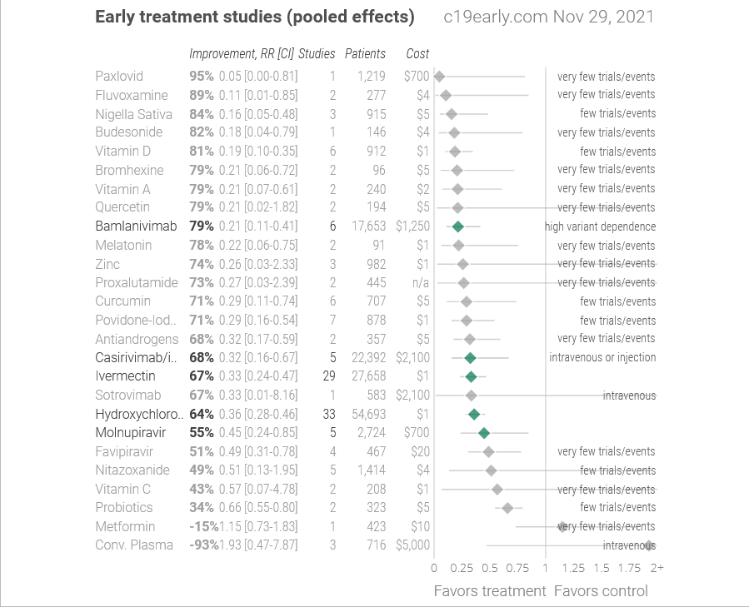
GREAT THERAPEUTIC WEBSITE
https://c19early.com/#fpearly
Notes:
This website is a fantastic resource for everyone as it compiles peer review literature regarding Covid-19, its treatment options and their efficacy.

Slide 26
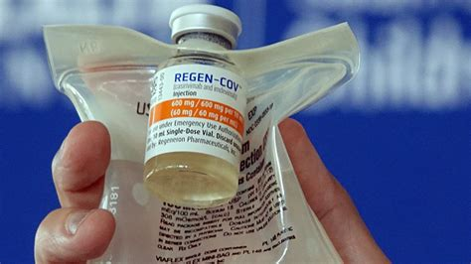
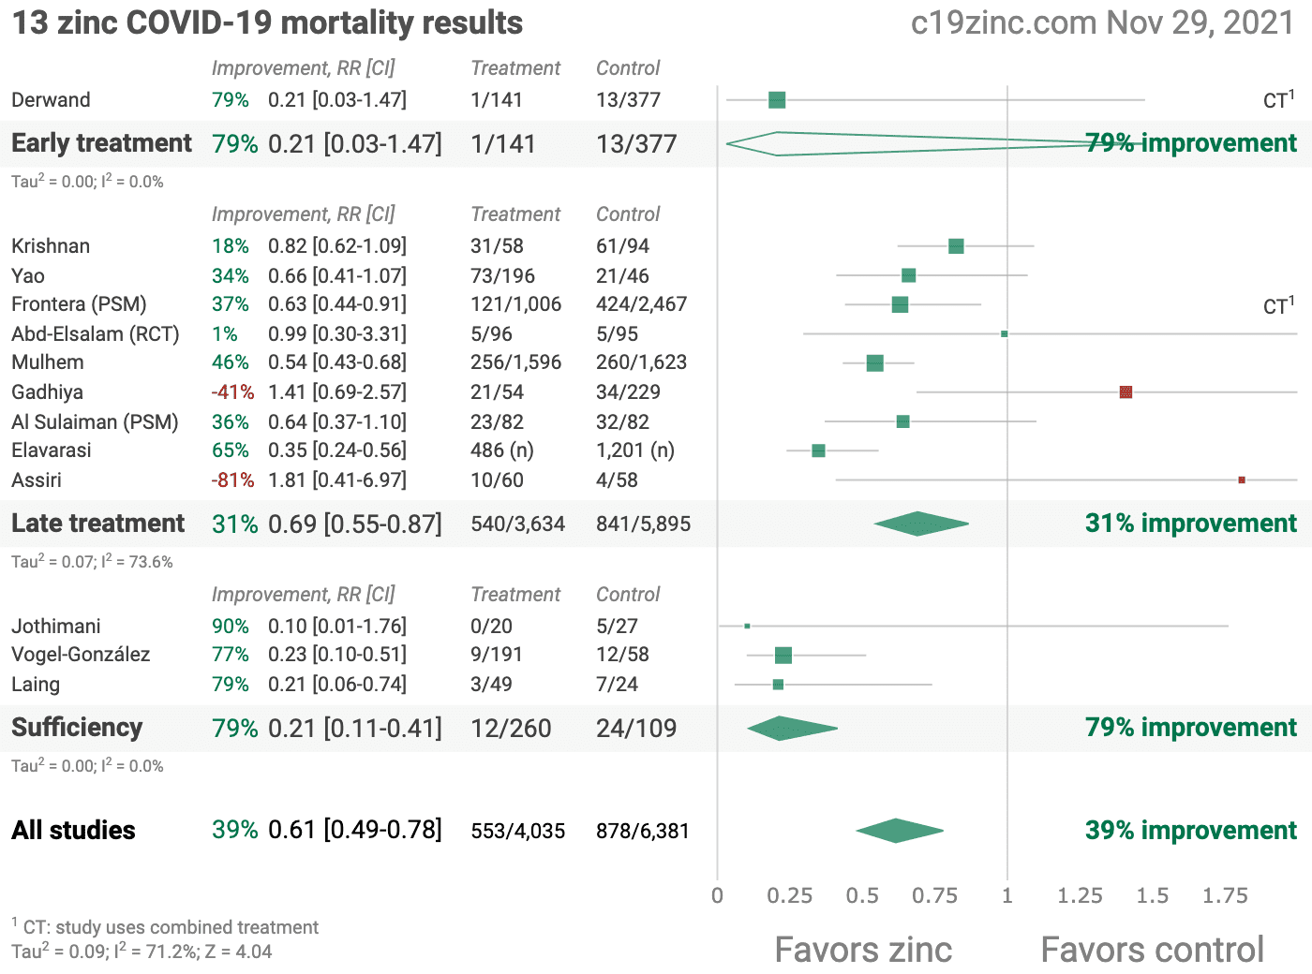
Monoclonal Antibodies
Notes:
Options that seem to work are Vitamin D. Vitamin C and Zinc together with Quercetin to get everything into the cells. With every treatment mentioned, the earlier it is started, the more effective. There are also monoclonal antibodies.
Here’s what DOESN’T work: Remdesivir has not been shown to be effective in any studies other than what the NIH/CDC puts out. Even the WHO doesn’t like it. And yet, it is the “go-to” treatment in the hospital. Who owns Remdesivir and how much does it cost? The US Pharma company, Gilead Pharma owns it jointly with the CDC and Army Medical Research Institute of Infectious Diseases and it is still under patent until 2037 so they have a monopoly and are charging through the roof (even though it has no impact on survival). It is several thousand dollars per IV infusion. Again, do you see a conflict of interest here? They made it for Ebola, but it was ineffective. So they got it approved for covid, since the CDC owns it AND stands to make a ton of money - and they make medical recommendations for the United States with no oversight. It doesn’t matter that it doesn’t work. When you own the medicine and you own the airwaves and the power to grant authority on behalf of the people, and you stand to make a heck of a lot of money, why wouldn’t you approve it even if it ends up killing hundreds of thousands of people?
Published data (May 2020) showed that "remdesivir was not associated with statistically significant clinical benefits [and] the numerical reduction in time to clinical improvement in those treated earlier requires confirmation in larger studies." But yet, in October 2020, remdesivir was granted approval by FDA based on promising data from relatively small trials with about 1000 participants.
A large-scale analysis by the World Health Organization's Solidarity trial consortium found based on interim results from studying more than 5000 participants, the international study concluded that remdesivir "had little or no effect on hospitalized patients with Covid-19, as indicated by overall mortality, initiation of ventilation, and duration of hospital stay."
As a consequence of being mostly ineffective, WHO recommends against the use of remdesivir in Covid-19 patients (November 2020).
With the data I showed you about the power of early treatment with effective antivirals, I think you have to ask the question, was this really a pandemic? Did it have to turn into one? Could we have stopped this if politics, Big pharma and Big Tech, Big Educational institutions and Big Government agencies stayed out of the way? If we could have used those off-label, safe and effective treatments early, there wouldn’t have been an EUA for an experimental “vaccine” with no long-term efficacy or safety studies. Those individuals who died “with” Covid-19 in their system may still be alive today.
Regardless of how our government failed to handle this virus in the past and is failing to handle it currently, we have the local power to change things NOW. We know more, we can do better. We can stop the fear-mongering and decide on truth and transparency and live by the medical Hippocratic Oath – that we should use medical knowledge to help rather than harm and that patients are to be treated not as cases or experimental subjects, but as human beings worthy of respect and compassion.

Slide 27
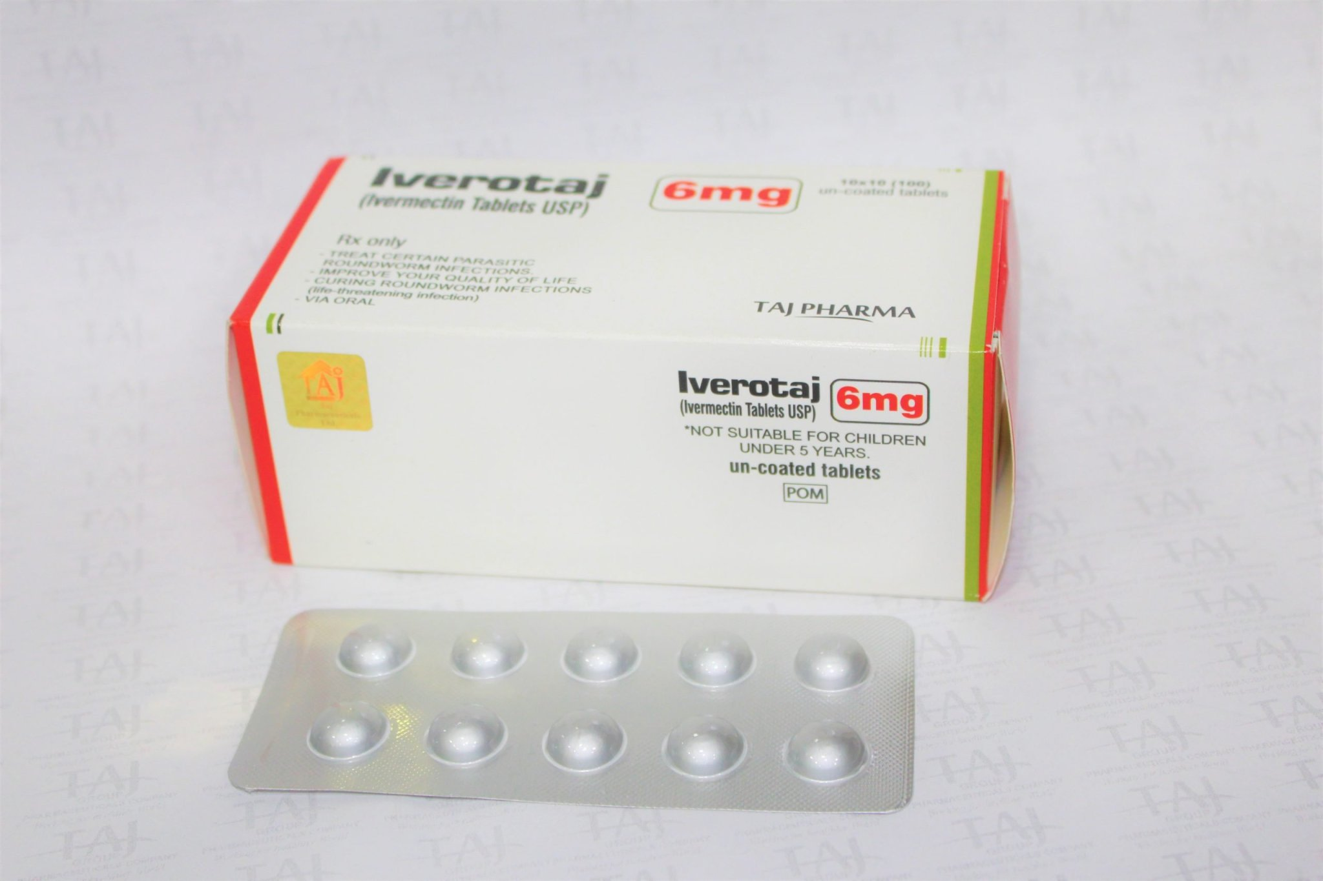
IVERMECTIN
Meta analysis using the most serious outcome reported shows 66% [53‑76%] and 86% [75‑92%] improvement for early treatment and prophylaxis, with similar results after exclusion based sensitivity analysis and restriction to peer-reviewed studies or Randomized Controlled Trials.
BIOCHEMIST CHRIS MARTENSON – September 29th, 2021. His rationale is simple: Safe. This proven drug has been used hundreds of millions of times worldwide for decades; It is safe and well-tolerated. Effective. Prominent meta-analyses have determined a strong signal, including randomized controlled trials and numerous observational studies by physicians like us.
Litigation Now Active against Dr. Soumya Swaminathan – World Health Organization Chief Scientist for disinformation and misguiding Ivermectin
Clinical Data from FLCCC and British Ivermectin Recommendation Development (BIRD)
Added on May 17, 2021 to “may do” category
Notes:
Ivermectin Efficacy Videos:
Video 1: Dr. Pierre Senate Visit December 2020 - IVERMECTIN
Video 2: The Story of Ivermectin and Covid-19 Video
Video 3: Australian Senator Video

Slide 28
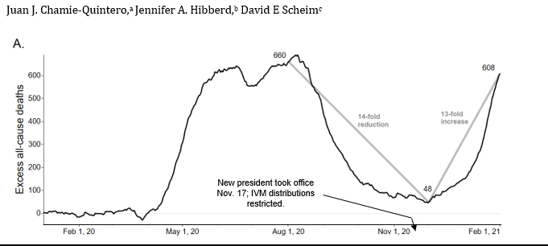
WHY THE CENSORSHIP!!!
Big Tech and alphabet companies labeling effective antivirals “misinformation”
FDA revokes EUA for HCQ on June 15, 2020
FDA recommended against Ivermectin on March 5, 2021
Doctors refusing to prescribe Ivermectin and HCQ
Pharmacists refusing to fill prescriptions for ivermectin and HCQ or if they do, expensive
Peruvian Case Study
Ivermectin WORKS against COVID and should be available to all!
Ivermectin won the 2015 NOBEL PRIZE in Medicine
Notes:
IVM has been safely used in 3.7 billion doses since 1987, well tolerated even at much greater than standard doses and used without serious AEs in the three high-dose COVID-19 treatment studies. In the current international emergency of COVID-19, with mutant viral strains, and potentially waning vaccinated induced immunities over months presenting new challenges, IVM can be an effective component of the mix of therapeutics deployed against this pandemic. The record of nationally authorized such treatments in Peru provides a clinical experience of IVM treatments for C19. In ten states of Peru, mass IVM treatments of COVID-19 were conducted through a broadside, army-led effort that began on different dates in each state. In these states, excess deaths dropped sharply over 30 days from peak deaths by a mean of 74%, in close time conjunction with start date. In 14 states of Peru having locally administered IVM distributions, the mean reduction in excess deaths over 30 days from peak deaths was 53%, Reductions in excess deaths by state (absolute values) correlated with the extent of IVM distribution. Nationwide, excess deaths decreased 14-fold over four months through 1st December 2020. After a restrictive IVM treatment policy was enacted under a new Peruvian president who took office on 17th November, however, deaths increased 13-fold over the two months following 1st December through 1st February 2021. Data are from Peru’s National Death Information System (SINADEF).
Uttar Pradesh – 230 Million $2.65 per early treatment kit if we extrapolated to USA = 330 million x $2.65 = 875 million to get every American a kit. We have spent 6 trillion so far.

Slide 29
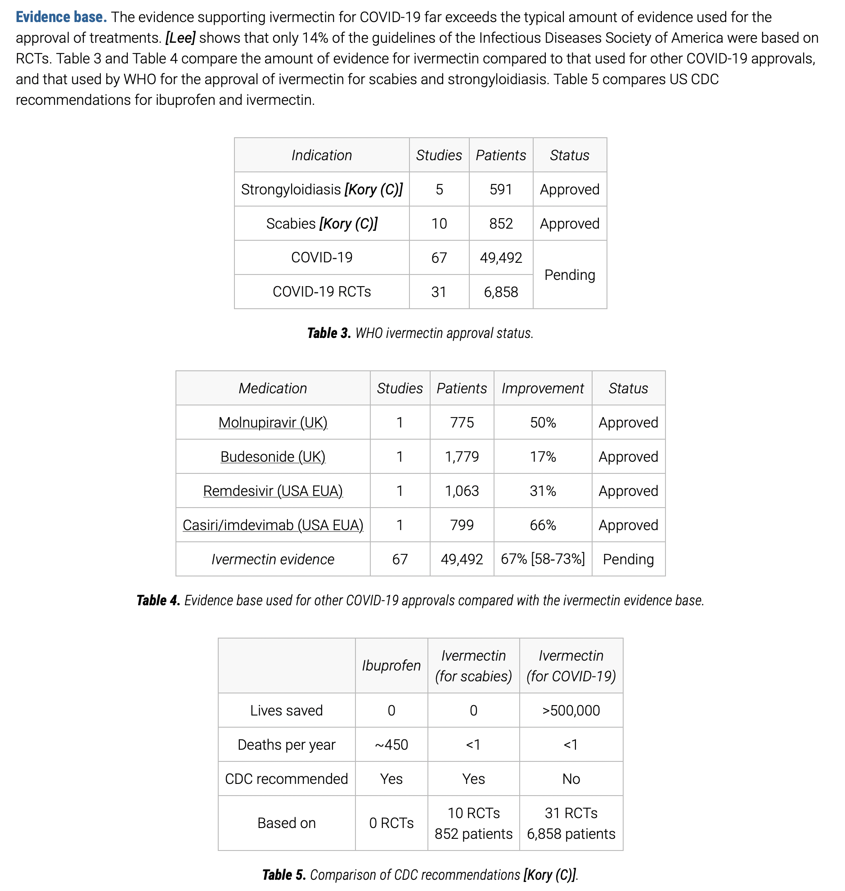

Slide 30
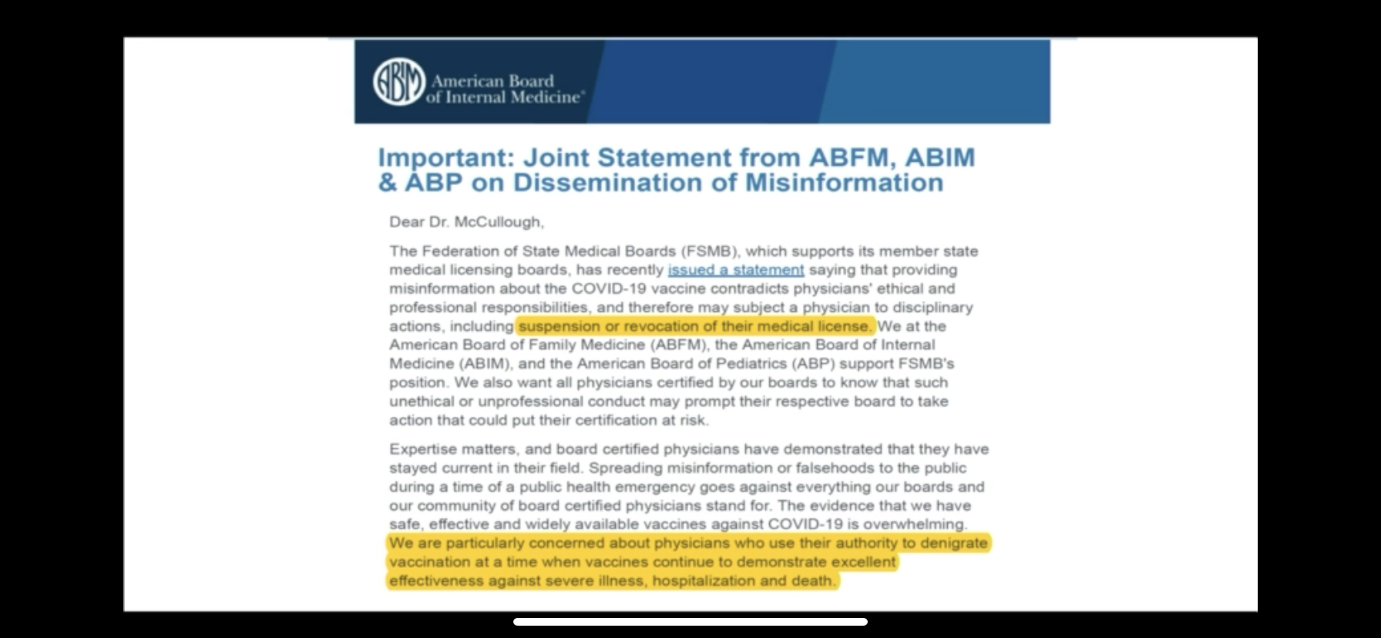
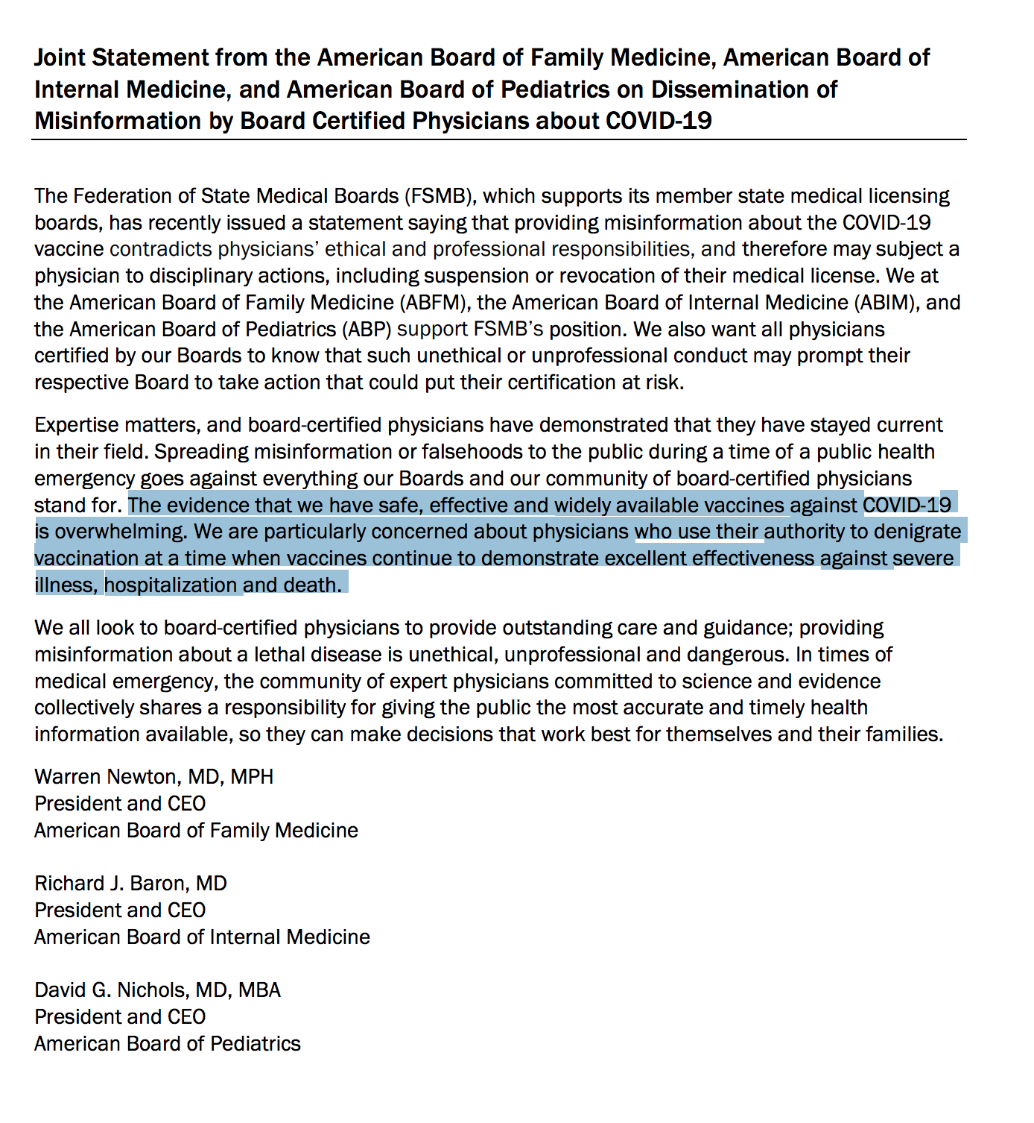
https://www.fsmb.org/advocacy/news-releases/fsmb-spreading-covid-19-vaccine-misinformation-may-put-medical-license-at-risk/
Notes:
So why the continued delay? Perhaps the association actions above are problematic?
Another concern is that the government is essentially threatening doctors with their license. The Federation of State Medical Boards came out with a July 29th 2021 statement that stated that spreading Covid 19 vaccine misinformation may put medical licenses at risk.
https://www.fsmb.org/advocacy/news-releases/fsmb-spreading-covid-19-vaccine-misinformation-may-put-medical-license-at-risk/ In other words, if they do not recommend the vaccination for EVERYONE, regardless of medical history, they could lose their license to practice. So, can we actually trust our doctors to provide us the best care knowing that by contradicting the CDC they may lose their careers? This includes our colleagues at the university who are fearful for their own careers. Everyone should have a big problem with this, considering a significant portion of the medical profession are refusing vaccination themselves. The American Board of Emergency Medicine (ABEM) on August 26 issued a similar warning stating that physicians who publicly spread misinformation about the Covid-19 pandemic risk losing their board certification.
There are doctors in Oklahoma that deserve credit for refusing to not treat their patients.

Slide 31
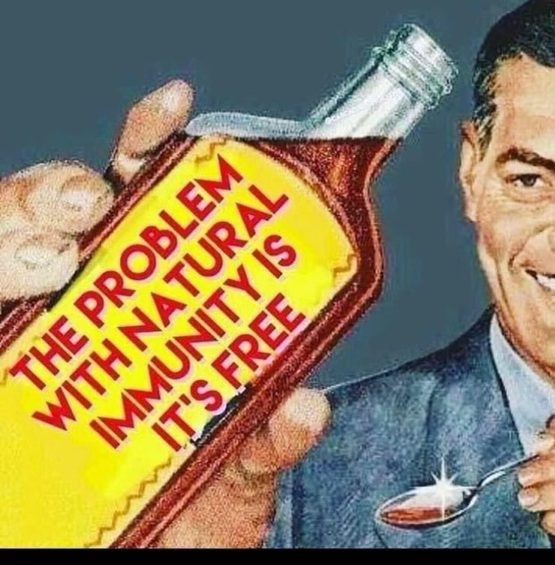
The Strength of Natural Immunity

Slide 32
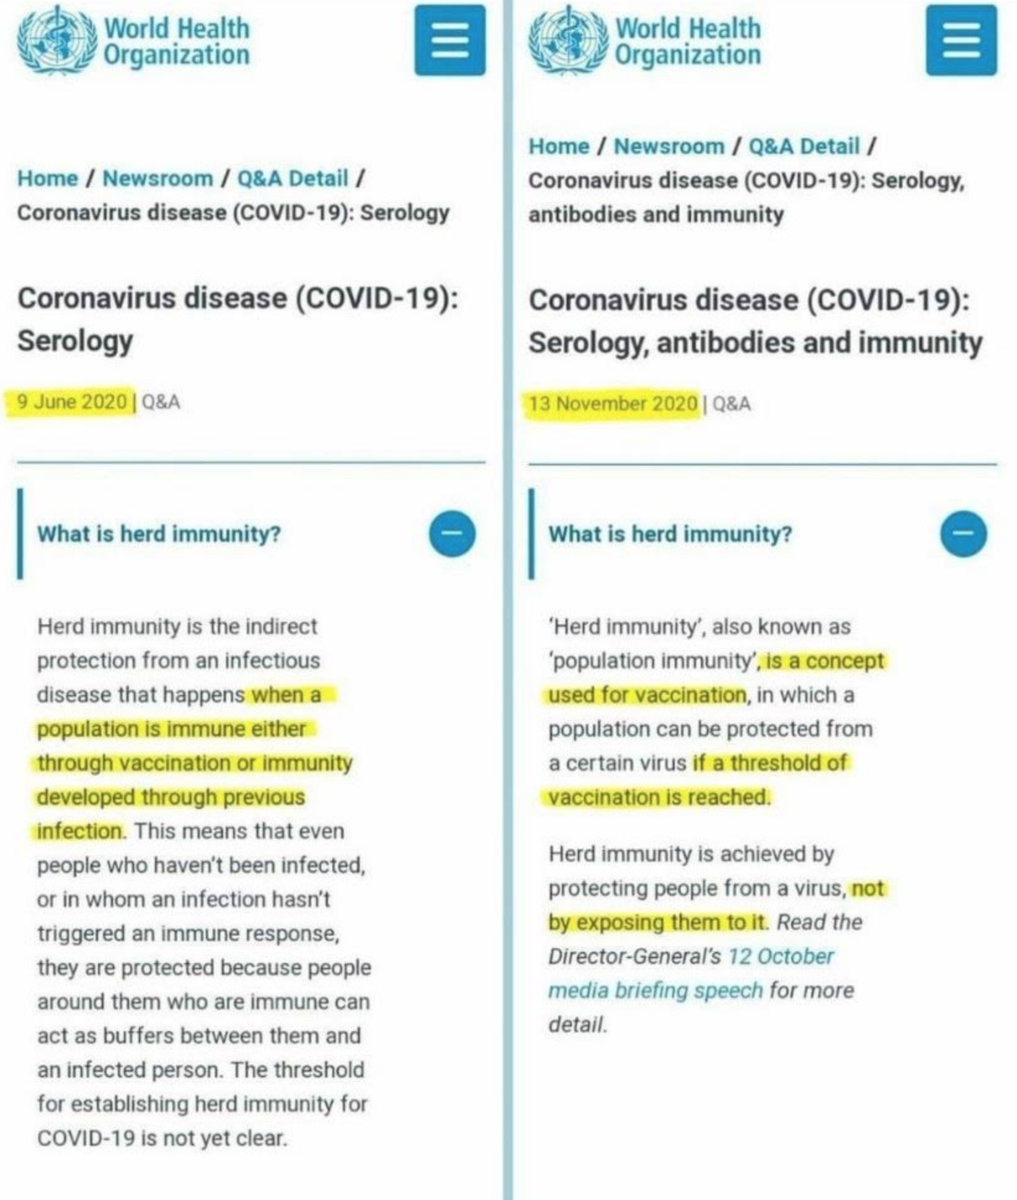
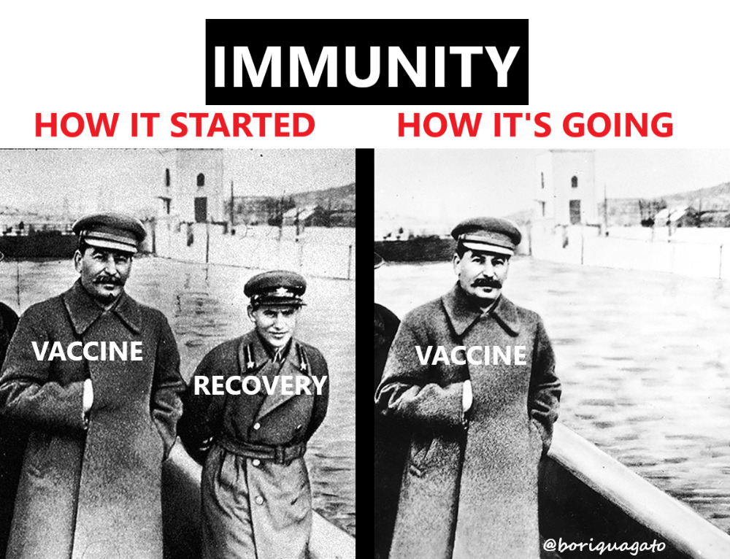
HERD IMMUNITY
Historically (and scientifically) Herd immunity = Previously infected + Vaccinated
Why was the definition of herd immunity changed to leave out natural immunity?
Notes:
It is well known science that there’s more than one kind of immunity in combating a disease and that we’ve relied on convalescent immunity to help get the community to herd immunity for most of the diseases we’ve seen in the past. But suspiciously, in the period of June 9, 2020 to November 13, 2020, the World Health Organization (WHO) decided to change their definition of Herd Immunity to exclude previous infection. Why? There are studies after studies after studies that show that convalescent immunity is superior to vaccinated immunity.
“A study of the blood of older people who survived the 1918 influenza pandemic reveals that antibodies to the strain have lasted a lifetime and can perhaps be engineered to protect future generations against similar strains. The group found that 100% of the subjects had serum-neutralizing activity against the 1918 virus and 94% showed serologic reactivity to the 1918 hemagglutinin. The B cells have been waiting for at least 60 years if not 90 years for that flu to come around again. That's amazing, because it's the longest memory anyone's ever demonstrated."
https://www.cidrap.umn.edu/news-perspective/2008/08/researchers-find-long-lived-immunity-1918-pandemic-virus
All people who recovered from SARS in 2003 had retained memory T cells induced by that original pathogen still in their systems. 18 years ago!! Sars-cov-2 patients had also produced similar T-cells. https://www.nature.com/articles/s41586-020-2550-z

Slide 33
Notes:
We are one of the only countries that does NOT recognize natural immunity----at all. A 700000 person study from Israel (August 2021) found that those who had experienced prior infections were 27 times less likely to get a second symptomatic covid infection than those who were vaccinated. This affirmed a June 2021 Cleveland study of 1,359 health care workers in which NONE who had previously tested positive for the coronavirus got reinfected over a 10 month study period. The study authors concluded that “individuals who have had SARS-CoV-2 infection are unlikely to benefit from covid-19 vaccination.” In Brazil (March 2021), a study found that there were only “three confirmed re-infections in the entire state, whose population exceeds four million. Other studies have confirmed that re-infections are rare and usually asymptomatic or mild.” That’s a 0.000075% risk of reinfection folks.
So what’s the problem? History has always been about IMMUNITY… not about a mandatory vaccination. Think about the chicken pox or the measles.

Slide 34
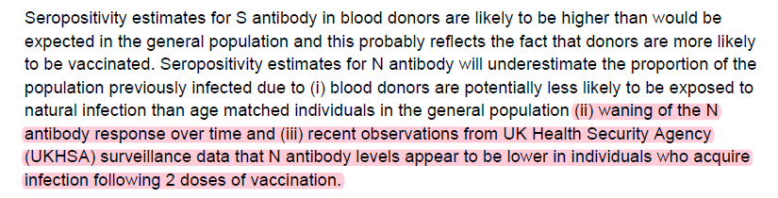
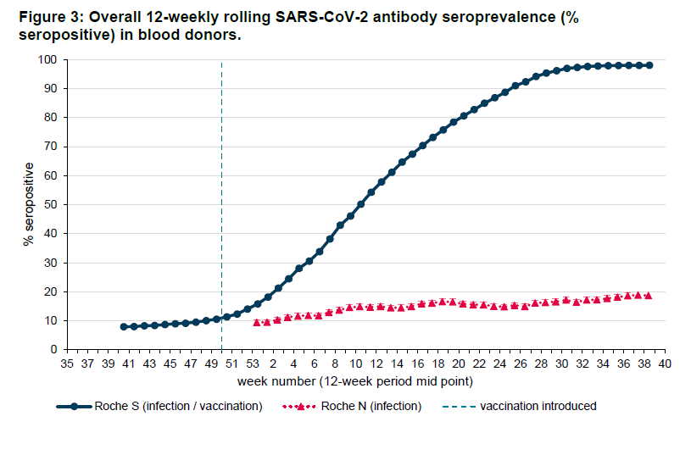
Notes:
Synthetic and Specific vs Non-Specific and Natural - Think Basketball 5 players on each team. Two separate games.
Game 1 : Team one has 5 identical twins (synthetic spike proteins), Team two has various individuals (virus and all variants).
Game 2 : Team one has various individuals (natural spike proteins), Team two has various individuals (virus and all variants).
Synthetic spike proteins cannot evolve with the changing game, they only know how to defeat the virus they are programmed to defeat.
Natural spike proteins are robust and evolve to defeat all variants.

Slide 35
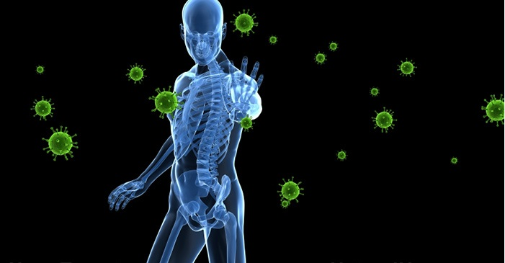
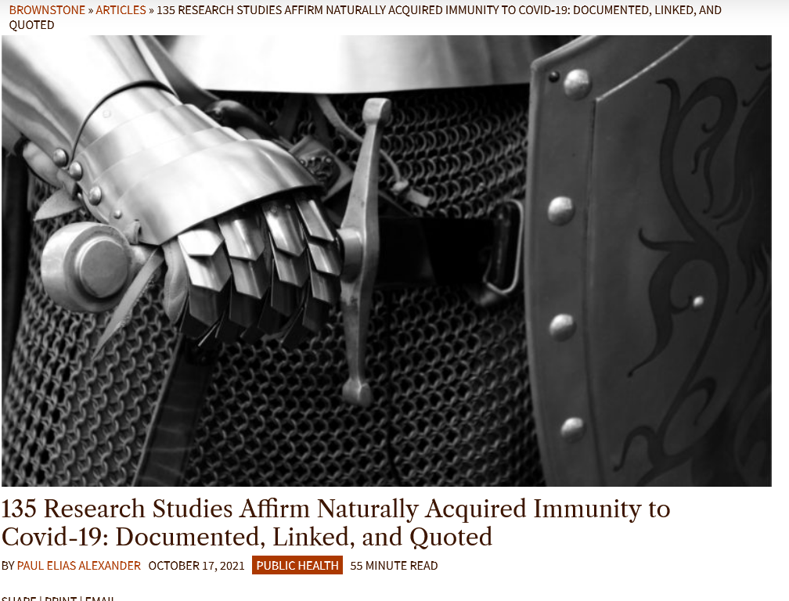
NATURAL IMMUNITY IS REAL!
Probable reinfection rates range from 0.000075-1%;
Of those confirmed with re-infection through seroprevalence testing (extremely small number), symptoms much milder because amount of virus in nose and throat much less
Natural immunity affords longer lasting and stronger protection against infection, symptomatic disease and hospitalization
Notes:
Some Natural Immunity Papers: October 11, this paper was published showing that “SARS-CoV-2-specific memory B and T cells reached a peak at 3-6 months and persisted in patients up to 15 months. The data suggest that antiviral specific immunity especially memory B cells in COVID-19 convalescent patients is long-lasting.”
UK weekly C19 report, August 19, 2021(Table on page 18): The “probable” reinfection rate from those with prior infection is just 0.025%, and unlike the vaccine, the trend has NOT worsened with DELTA.
August 22, 2021: Aside from more robust T cell and memory B cell immunity, which is more important than antibody levels, Israeli researchers found that antibodies wane slower among those with prior infection. "In vaccinated subjects, antibody titers decreased by up to 40% each subsequent month while in convalescents they decreased by less than 5% per month."
August 25, 2021: 700,000 person Israeli data set showed that “the vaccinated were ultimately 13x likely to be infected as those who were infected previously and 27x more likely to be symptomatic”….“SARS-CoV-2-naïve vaccinees had a 13.06-fold (95% CI, 8.08 to 21.11) increased risk for breakthrough infection with the Delta variant compared to those previously infected….” SARS-CoV-2-naïve vaccinees were also at a greater risk for COVID-19-related-hospitalizations compared to those that were previously infected. "This analysis demonstrated that natural immunity affords longer lasting and stronger protection against infection, symptomatic disease and hospitalization due to the delta variant,"
UK, ONS Study, August 25, 2021: “Less than 1% of people who caught C19 and recovered were infected again and were half as likely to suffer symptoms if reinfected.”… “the amount of virus presented in the nose or throat during a second infection was much less than during first infection.”
J&J vaccine clinical trial data report: “An unvaccinated person previously infected with SARS-CoV-2 has a 99.9% chance of being protected from a repeat infection.” Physicians for Informed Consent calculate that 180 million Americans have already been infected and are protected.

Slide 36
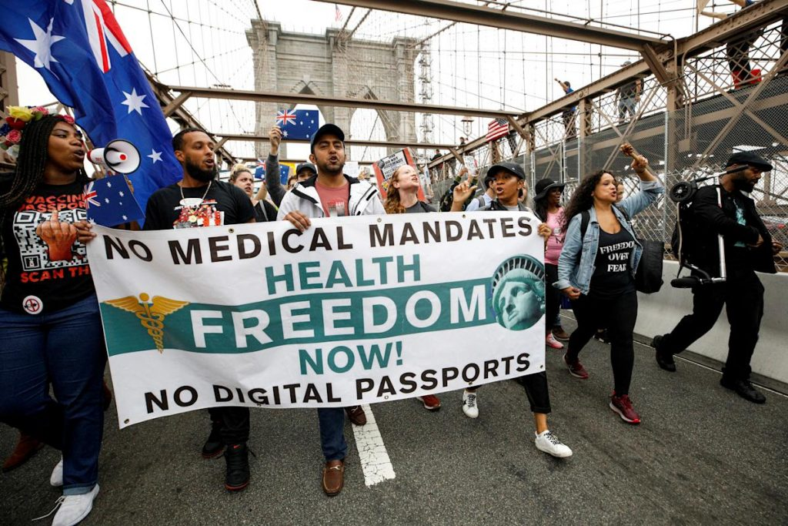
WHY VACCINATE A PERSON ALREADY IMMUNE TO VIRUS?
Those with prior infection are associated with 4.4 times increased odds of clinically significant side effects following a mRNA vaccination. - JAMA
Adverse effects are more frequently reported in younger individuals, women, and among those who previously had COVID-19. - Lancet
Vaccination was most strongly associated with an elevated risk of myocarditis and “the risk of this serious adverse event and of many other serious adverse events was substantially increased after a previous SARS-CoV-2 infection.” - NEJM
“In individuals with a pre-existing immunity against SARS-CoV-2, the second vaccine dose not only fail to boost humoral immunity but determines a contraction of the spike-specific T cell response."
“The second vaccination dose appears to exert a detrimental effect in the overall magnitude of the spike-specific humoral response in COVID-19 recovered individuals." - Cell Reports
Notes:
JAMA Internal Medicine published data that revealed those with prior infection are associated with 4.4 times increased odds of clinically significant side effects following a mRNA vaccination.
The New England Journal of Medicine published and provided an analysis of data from Israel to evaluate the safety of the mRNA vaccine. They found that vaccination was most strongly associated with an elevated risk of myocarditis and “the risk of this serious adverse event and of many other serious adverse events was substantially increased after a previous SARS-CoV-2 infection.”
Immunologists from Mt. Sinai in NY and Hospital La Paz in Madrid: After monitoring a group of vaccinated people both with and without prior infection, they found "in individuals with a pre-existing immunity against SARS-CoV-2, the second vaccine dose not only fail to boost humoral immunity but determines a contraction of the spike-specific T cell response." They also note that other research has shown "the second vaccination dose appears to exert a detrimental effect in the overall magnitude of the spike-specific humoral response in COVID-19 recovered individuals."
People who have recovered from C19 infection have no benefit from vaccination at all, no reduction of symptoms, no reduction in hospitalizations and suffer 2-4 times the rate of side effects if they are subsequently vaccinated.
Even the document “Vaccines to Prevent C19 EUA” (https://www.fda.gov/media/142749/download) reveals that "Vaccine safety and COVID-19 outcomes in individuals with prior SARS-CoV-2 infection, who might have been asymptomatic, are important to examine because screening for prior infection is unlikely to occur prior to administration of COVID-19 vaccines under EUA.” (But what if these same individuals are using the PCR test as a screening measure at 35 threshold cycle? How can we know if the infection is actually valid?) “An EUA request should include subgroup analyses of safety and efficacy endpoints stratified by prior infection status at study entry, as determined by pre-vaccination serology or medical history." page 11, d.
Can someone please explain to WE THE PEOPLE how we are examining safety or assessing immunity prior to forced vaccinations? I’ve just presented several studies showing a prior infection increases the risk of harm from vaccination.
Why would we purposely HARM people with an intervention with no long-term safety data when we know that convalescent immune folks have superior immunity? For a virus that has an overall survivability rate of 99.8% across all demographics! Even people who had asymptomatic C19 have long-lasting immunity and that is why we should test antibodies for everyone PRIOR to recommending a vaccination.
We should all be demanding an answer to these questions:
Why is the government recommending vaccinating EVERYONE regardless of immunity status and why are vaccination MANDATES coming from employers regardless of immunity status? Who is liable for harm?
It should seem obvious to an intellectually honest person that an unvaccinated individual with prior infection is exponentially safer to be around than someone who had the vaccines but no prior infection.

Slide 37
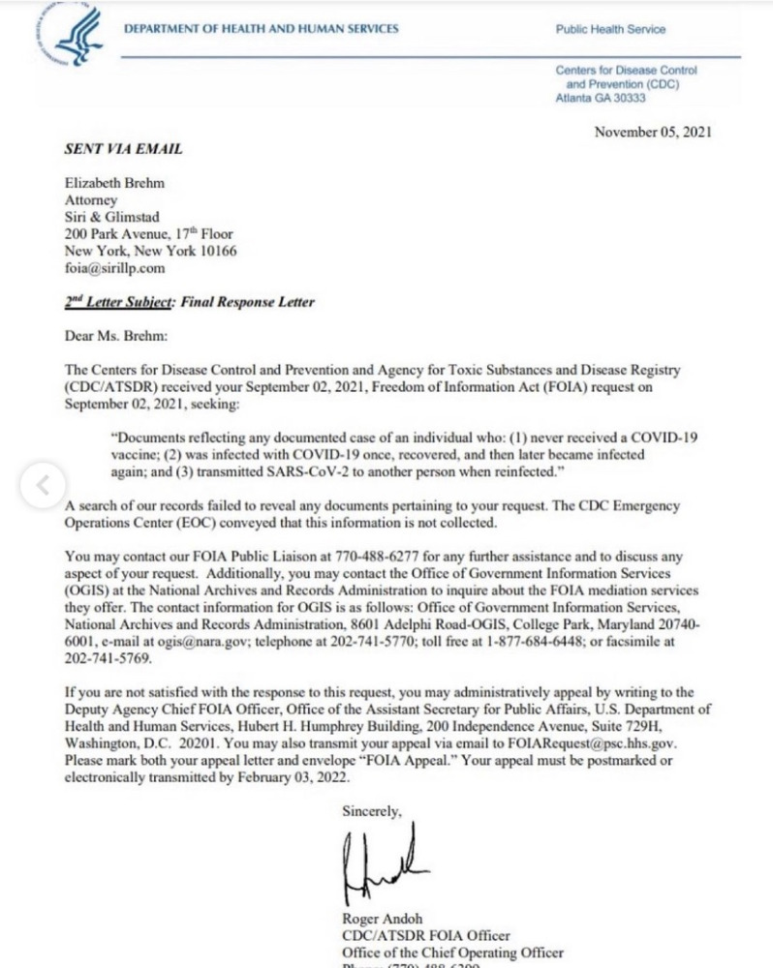
FOIA Request to CDC on Database of a Convalescent Immune Person’s Reinfection and Transmission Rate
“You would assume that if the CDC was going to crush the civil and individual rights of those with natural immunity by having them expelled from school, fired from their jobs, separated from the military, and worse, the CDC would have proof of at least one instance of an unvaccinated, naturally immune individual transmitting the COVID-19 virus to another individual. If you thought this, you would be wrong.” ~Aaron Siri, lawyer
Does Oklahoma record convalescent immune reinfections, hospitalizations or deaths?

Slide 38
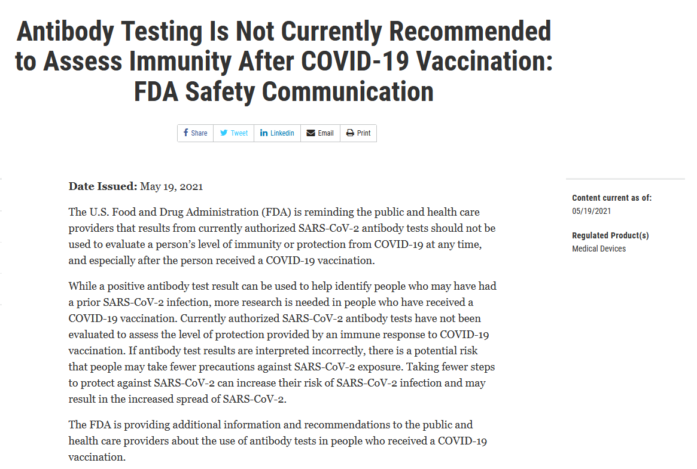
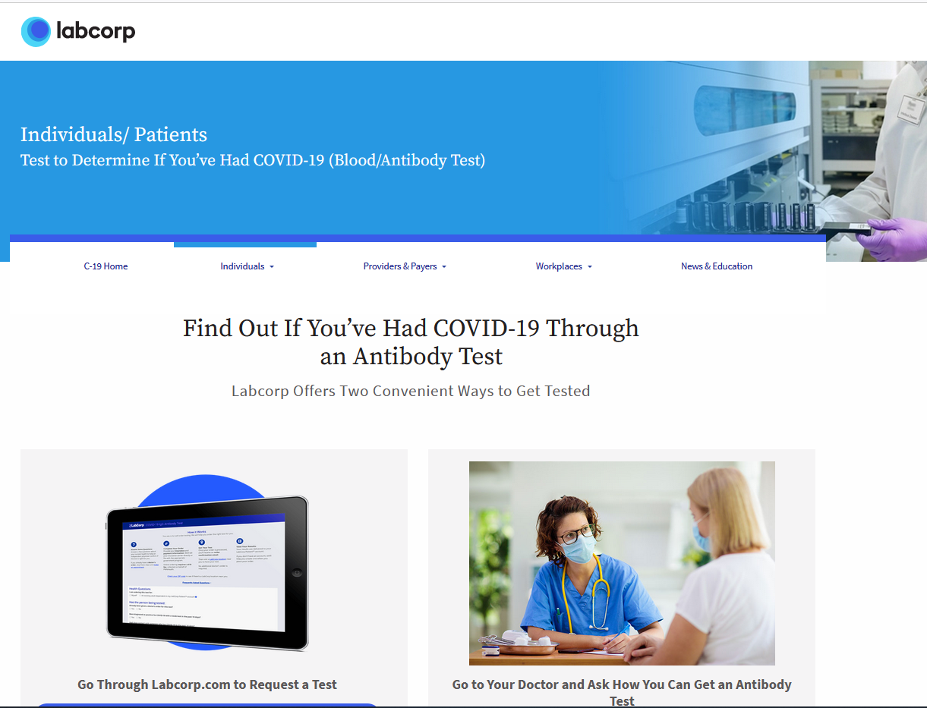
TESTING TO ASSESS IMMUNITY
https://www.labcorp.com/coronavirus-disease-covid-19/individuals/antibody-test
Notes:
If the government or individual who we elect to represent us are truly concerned about the infection and transmission of, and subsequent immunity to, C19, why not require an antibody test and T-cell/B-Cell test?
Ahhh.. but wait. The FDA doesn’t want you to know what your antibody levels are. Why? Because the vaccination doesn’t produce antibodies to sars-cov-2. Only a natural infection does that.
There is a publically available T-Detect Test (https://www.t-detect.com/) we might use. I’m not sure I trust anything that has Bill Gates associated with it, but it is interesting and the only one I can find that is available to the public. The website claims it outperforms serology (antibody) tests and we definitely need to do more research into the test prior to recommending it for individuals.
In order to better understand how vaccinations create immunity versus how natural infection creates immunity in their population, the UK is starting an antibody surveillance program. This is a great research study for those who are willing to participate through INFORMED CONSENT. Why aren’t researchers in the United States doing this? Having individuals volunteer to get antibody tests every 4-6 months and T-Cell tests periodically to see what is happening in their bodies would be advantageous in planning to better manage the virus. It would also be advantageous for those individuals who chose (not coerced or forced) to vaccinate to know how well they are protected from this gene therapy?
There are plenty of published documents providing levels of these immunity indicators that could be used to assess whether or not an individual has adequate immunity toward a further infection, whether that be from a previous infection or a vaccination (understanding that the vaccination immunity only provides part of the immunity needed to ward off future infection). That seems a prudent step forward as an alternative to vaccination mandates, if we are truly worried about herd immunity and community safety and not just about how many vaccines and boosters big Pharma, through the CDC, can sell.

Slide 39
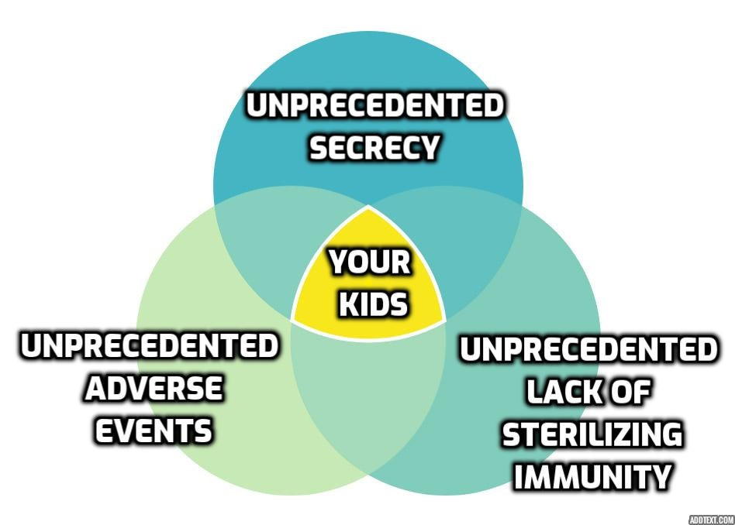
The Vaccine, Safety and Failure to Protect

Slide 40
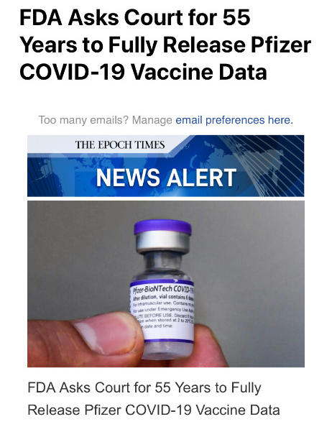
VACCINES
1. Injection must give you antibody immunity to a virus or bacterium.
2. That antibody must give you protection from that virus or bacterium
3. The injection must show that it reduces hospitalizations, deaths or severe symptoms of that virus or bacterium
4. That injection must show that it stops a person from carrying that virus or bacterium
5. That injection must show that it stops the transmission from one person to the next of that virus or bacterium.
Notes:
When we teach children about the dangers of drugs and alcohol, medications, etc. The first conversation we have is “What is it? Ingredients?” What are we putting into our bodies and how does it react? Does it react differently across age groups, genders, medical history or prior infection? Does dosing matter? Has it been tested?
Has anyone answered these questions regarding the currently available C19 vaccinations (Pfizer/BioNTech, Moderna, AstraZeneca, Johnson & Johnson (Janssen), Sputnik-V, Novavax, Coronavac, Sinopharm,Tianjin CanSino, Covaxin)?
1. The injection does not give you antibody immunity to the virus. It may give you antibody immunity to the spike protein, but that spike protein is not specific to the SARS-CoV-2 virus. The FDA came out and told us that antibody testing is not effective in determining immunity among the vaccinated. Are they telling us that they KNOW the vaccine doesn’t provide antibody immunity to the SARS-CoV-2 VIRUS? If not, what does it provide? In several published scientific articles, researchers find that the injection produces serum immunoglobulin G (IgG) antibodies against the S1 spike protein. Read that again. Injected people produce antibodies against the S1 spike protein, NOT antibodies against the SARS-CoV-2 VIRUS!!!!. This paper, published on August 16, 2021, states that “nearly 100% of Hospital Workers in this study mounted a strong antibody response to the spike protein after dose 2 of the SARS-CoV-2 mRNA vaccine, independent of vaccine-induced reactions.” Folks. The FDA came right out and told you the vaccine doesn’t protect against the SARS-CoV-2 virus. It only produces antibodies against a S1 Spike Protein, which is not unique to the SARS-CoV-2 virus.
2. The antibody immunity is supposed to give you protection against the virus. Not only has that not been shown in any study, but the authorities have stated that they don’t know if the injection will give you protection from a SARS-CoV-2 infection.
3. The injection was not studied to see if it would reduce deaths, hospitalizations or severe symptoms of SARS-CoV-2 infection of anyone that received the injection. They even said that we don’t know if it will reduce deaths or hospitalizations or severe symptoms. They also said that it may reduce symptoms. But there was no mention of it protecting you from the SARS-CoV-2 viral infection, or stopping you from dying, or being hospitalized or developing severe symptoms. The number of severe breakthrough cases is worrisome.
4. There were no studies done to see if by getting the injection you would no longer carry the SARS-CoV-2 virus and we now know it does not.
5. There were no studies done to see if you would stop transmitting the virus after injection and we now know it does not.
None of the five criteria were met to meet the definition of the vaccine. This injection is not a vaccine. It was never meant to protect against the SARS-CoV-2 virus infection and the authorities even told you that they didn’t think that it would. After the injection was given, there were some studies published that showed that the injection did stop the transmission from one to another. And that was determined by a negative PCR test. The problem is that the PCR tests were manipulated to change the cycle thresholds that would preferentially give them a false-negative result when they wanted a negative result.
if the vaccines do not stop infection and transmission, then even if they provide some health benefit (and it is far from clear they have a net health benefit for healthy adults under 50, and possibly older), they SHOULD NEVER, NEVER, NEVER be mandated.

Slide 41
EVOLVING DEFINITION OF VACCINES
The original definition (pre-2015) stated that a vaccination was an “injection of a killed or weakened infectious organism in order to PREVENT the disease.”(Archived July 10, 2012).
They altered it in 2015 to “the act of introducing a vaccine into the body to PRODUCE IMMUNITY to the disease.”(Archived February 14, 2015) (Archived August 26, 2021)
Then in September 2021, they altered the definition again to say “the act of introducing a vaccine into the body to PRODUCE PROTECTION from a specific disease.” (Archived September 2, 2021)
Instead of requiring medicine to meet the definition of “vaccine,” it appears the CDC has changed the definition of “vaccine” to accommodate what the injection actually does (maybe).
Notes:
How many research studies of the various vaccines were conducted prior to emergency use authorization (EUA)? Why was emergency use authorization necessary if we had therapeutic options that worked? (see the section on therapeutics.
MSM keeps parroting to the public that this vaccine is safe and effective. What is safe about the Covid injections, specifically those containing mRNA? Consider the following.
mRNA technology has never been used successfully as a vaccine to prevent infectious disease or to demonstrate its ability to reduce the incidence of infectious disease in humans, ever. So whether or not this material is safe and effective is completely unknown. Because it has never been utilized in humans. We have no history of use.
No studies have ever been done to demonstrate what happens to the genetic material that makes up this mRNA that is meant to get the body to produce the spike protein. We don’t know what happens to the mRNA after it is injected into the body. We will hear experts state that the mRNA doesn’t last or doesn’t continue to force the body to produce spike proteins, but if you ask them where the study has been done to demonstrate that this mRNA from this vaccine does what they say it does, you will not find any. Any statement that this mRNA is turned off and will not continue to force the body to produce spike protein is false. We don’t know whether the body will continue to manufacture mRNA and therefore spike proteins.
Spike protein in the Covid 19 illness has been shown to be the very piece of material that causes the symptoms of Covid 19; brain damage, neurological issues, causes heart attacks, lung disease, crosses the blood-brain barrier, liver damage, spleen damage, kidney damage and affects the male and female reproductive systems. So why would you allow an injection to be put into your body that asks your body to make spike protein, the very material that is known to cause the symptoms of Covid to cause the damage that it does in C19 and potentially increase your possibility as a long-hauler. Why would you do that when the scientist and the experts don’t have an answer if the body ever stops producing spike proteins.
The ingredients that are in the injection have never been used before in any vaccine that we know of, in the history of vaccinations. We have no safety profile of what happens to any of these ingredients once they are injected into the body nor do we have any understanding what the ingredients combined with each other will do once they are injected into the body. There are lipid nanoparticles that are in this injection that if you open up pub med and simply look up what happens to the body when lipid nanoparticles are injected into the body, the literature shows very clearly that brain, lung, heart, blood, liver, kidney, male and female reproductive damage occurs to the point of cancer and infertility.
Consider the lipid nanoparticle and what that is. When drug manufacturers first figured out there was a blood-brain barrier that prevented drugs from going from the bloodstream to the brain, they had a problem because they had to figure out how to treat brain diseases.
As a result they needed to find a way to get the drug from the bloodstream to the brain and they developed nano-particles to bind to the drugs to get them into the brain. If the drug companies are using nano-particles to bind to drugs to enhance the delivery of drugs from the bloodstream to brain to treat brain conditions, then do nanoparticles in vaccines, which are tightly bound to bacterial particles (and spike proteins), go into the brain also, performing typically as nanoparticles would? If you get a doctor to answer that question, let me know because so far everyone either doesn’t know or is refusing to answer it.
Pfizer Sheet - which was given to individuals in Oklahoma in January/February. Then to next slide:
November 2nd CDC Emails: https://technofog.substack.com/p/cdc-emails-our-definition-of-vaccine

Slide 43
Notes:
Pfizers research organization falsified data in their Phase 3 Covid-19 Vaccine Trial. They fired those who complained about unethical trial practices who has documentation to back up this claim. The BMJ that the company falsified data, unblinded patients, employed inadequately trained vaccinators, and was slow to follow up on adverse events reported in Pfizer’s pivotal phase III trial.
Citation: https://www.bmj.com/content/375/bmj.n2635

Slide 44
ADVERSE EFFECTS KNOWN FROM TRIALS (OCTOBER 22, 2020)
Guillain-Barre Syndrome
Acute Disseminated Encephalomyelitis
Transverse Myelitis
Convulsions/Seizures
Stroke
Narcolepsy
Anaphylaxis
Acute Myocardial Infarction
Myocarditis/Pericarditis
Autoimmune Disease
Deaths
Pregnancy and Birth Outcomes
Thrombocytopenia
Venous Thromboembolism
Kawasaki Disease
Multisystem Inflammatory Syndrome in Children
Vaccines and Related Biological Products Advisory Committee (VRBPAC) Meeting
Notes:
Dr. Ardis: Vaccines and Related Biological Products Advisory Committee (VRBPAC) Meeting October 22, 2020.
Center for Biologics Evaluation and Research (CBER)
Dr. Robert Malone who is credited with the creation of mRNA molecule, at the Salk Institute in 1988 has recently come out to say that the spike protein does not stay in the injection site but travels throughout the body and can attach to cells in the Brain, Heart, Liver, Kidney and Ovaries (https://www.ncbi.nlm.nih.gov/pmc/articles/PMC8051011/). We have confirmed cases of strokes, heart disease in healthy young people that was recently added to the Fact Sheet for all vaccines, miscarriages, organ failures, neurological conditions –all severe cases and more deaths after the vaccine rollout than from all other vaccines over a 20 yr period. (https://vaers.hhs.gov/data.html) As of August 12th, 2021 we have 451,049 reports of adverse reactions to the C19 vaccines.
Dr. Vladimir Zelenko (President Trump’s personal doctor when he had Covid-19, treated the Israeli Minister of Health, The Brazilian President, ALL OF THE WORLD LEADERS!), talked with Israeli politicians and the health minister about the vaccines and effective therapeutics here: https://www.bitchute.com/video/WsvhxBD4k1uZ/
He notes that the Pfizer CES has said that “Israel is the biggest study in the world” for how these vaccines react in a human population. Interesting to note that Israel entered into an agreement with Pfizer (https://govextra.gov.il/media/30806/11221-moh-pfizer-collaboration-agreement-redacted.pdf) to mass vaccinate its population and exchange vaccine supply for public health data to “evaluate whether herd immunity protection is observed during the Product vaccination program rollout.”
He discusses concerns about acute (short term - moment of injection to 3 months) like blood clots, heart attack, stroke, inflammation of the heart and miscarriage, sub-acute (mid-range) like pathologically disastrous immune reactions and long-term concerns like infertility (damage to ovarian function and reducing sperm count).
A paper posted on July 20, 2021 discusses how the spike protein disrupts human cardiac function. The spike protein found on the surface of the C19 virus cells causes changes to cells in the small blood vessels of the heart.
It is devastating that we started vaccinating pregnant women before we had any safety data, contrary to the rules mandated by the FDA regarding EUAs.
Pfizter listed a number of drugs and products that contributed to its significant Q2 growth, but the drugs Eliquis and Vyndaqel. Eliquis – which saw 13% growth – treats blood clots, and Vyndaqel – which saw 77% growth – treats cardiomyopathy. Is there a correlation to vaccine adverse effects? Citation to 2nd quarter report/earnings

Slide 45
VAERS
VAERS was established in 1990 to detect safety issues with U.S. licensed vaccination. https://vaers.hhs.gov/about.html
Detect new, unusual, or rare vaccine adverse events;
Monitor increases in known adverse events;
Identify potential patient risk factors for particular types of adverse events;
Assess the safety of newly licensed vaccines;
Determine and address possible reporting clusters (e.g., suspected localized [temporally or geographically] or product-/batch-/lot-specific adverse event reporting);
Recognize persistent safe-use problems and administration errors;
Provide a national safety monitoring system that extends to the entire general population for response to public health emergencies, such as a large-scale pandemic influenza vaccination program.
For context: There are hundreds of millions of doses of vaccines given annually across roughly 70+ vaccines. https://openvaers.com/covid-data

Slide 46
https://vaersanalysis.info/2021/11/19/vaers-summary-for-covid-19-vaccines-through-11-12-2021/

Slide 47
VAERS
Details, Details, Details
Over 80% of the adverse events, hospitalizations and deaths from Covid-19 vaccines occur within 14 days of getting vaccinated.
CDC counts over 80% of vaccine adverse events, hospitalizations, and deaths as “unvaccinated”
https://openvaers.com/covid-data
As of November 12, 2021
Notes:
https://openvaers.com/covid-data

Slide 48
Adverse Event Reporting Systems
https://www.adrreports.eu/en/index.html
Source: https://openvaers.com/covid-data
Notes:
VAERS and EUDRAVIGILANCE (EUROPE) DATABASES BOTH CONCERNING. NATIONAL VACCINE INFORMATION CENTER (www.nbic.org).
WHY ARE PUBLIC HEALTH OFFICIALS AND POLITICIANS IGNORING THE VAERS DATA, AND THE EUDRAVIGILANCE DATABASES.
I WAS NOT ABLE TO GAIN ACCESS TO THE UK YELLOW CARD DATABASE.
Eudravigilance Data Summary Table: https://vaccineimpact.com/2021/31014-deaths-2890600-injuries-following-covid-shots-in-european-database-of-adverse-reactions-as-young-previously-healthy-people-continue-to-die/
Where are our safety reviews? Malfeasance! Our CDC, FDA, NIAID, NIH, White House Task Force 1, 2, Senate 1, 2… ALL IMPLICATED. None of them demanded a safety report back in February.
Early safety warning failed. Even back in April 2021. Too many deaths reported. Sadly we have over 20,000 Americans permanently diabled. Needed external review board… Advisory panel voted 16-2 against boosters.
Vaccines Generally unsafe and don’t work well.
Increase in cancers and autoimmune diseases in patients who have been vaccinated: https://www.lifesitenews.com/news/idaho-doctor-reports-a-20-times-increase-of-cancer-in-vaccinated-patients/ “Since January 1, in the laboratory, I’m seeing a 20 times increase of endometrial cancers over what I see on an annual basis,” reported Dr. Cole. Cole explained that two types of cells are required for adequate immune system function: “Helper T-cells,” also called “CD4 cells,” and “killer T-cells,” often known as “CD8 cells.”
According to Cole, in patients with HIV, there is a massive suppression of “helper T-cells” which cause immune system functions to plummet, and leave the patient susceptible to a variety of illnesses.
Similarly, Cole describes, “post-vaccine, what we are seeing is a drop in your killer T-cells, in your CD8 cells,”
“And what do CD8 cells do? They keep all other viruses in check,” he continued. Much like HIV causes immune system disruption by suppressing CD4 “helper” cells, the same thing happens when CD8 “killer” cells are suppressed. In Dr. Cole’s expert view, this is what seems to be the case with the COVID-19 jabs.
Cole goes on to state that as a result of this vaccine-induced “killer T-cell” suppression, he is seeing an “uptick” of not only endometrial cancer, but also melanomas, as well as herpes, shingles, mono, and a “huge uptick” in HPV when “looking at the cervical biopsies of women.” Dr. Michael Yeadon, a former vice president at Pfizer, has cited the German study as a possible explanation for the large number of menstrual irregularities and miscarriages being reported by vaccinated women.
Yeadon warns young women to avoid the vaccine for, in his expert opinion as a toxicologist, the shots will likely impede a woman’s ability to get pregnant and carry a baby to term.
Dr. Cole states in his video that, not only are melanomas showing up more frequently, like endometrial cancers, the melanomas are also developing more rapidly, and are more severe in younger people, than he has ever previously witnessed.
“Most concerning of all, there is a pattern of these types of immune cells in the body keeping cancer in check,” stated the doctor.
“I’m seeing invasive melanomas in younger patients; normally we catch those early, and they are thin melanomas, [but] I’m seeing thick melanomas skyrocketing in the last month or two,” he added.
EudraVigilance October 2021: http://republicbroadcasting.org/news/28103-deaths-2637525-injuries-following-covid-shots-in-european-database-of-adverse-reactions-european-members-of-parliament-speak-out/
https://vaccineimpact.com/2021/21766-dead-over-2-million-injured-50-serious-reported-in-european-unions-database-of-adverse-drug-reactions-for-covid-19-shots/

Slide 49
Cardiac Events Due to Vaccination
Notes:
https://www.sciencedirect.com/science/article/pii/S0146280621002267?via%3Dihub (why did this paper get retracted).
https://www.dagbladet.no/sport/sogndal-spiller-kollapset-pa-banen/74507906 (put this in google chrome with the google translator to read it)
ALL-CAUSE MORTALITY, ESPECIALLY AMONG PEOPLE UNDER 50, HAS JUMPED THIS YEAR ACROSS THE UNITED STATES AND EUROPE.
No one knows why. No one is even trying to explain why. NO ONE IS EVEN DISCUSSING THIS. And now some of the healthiest young men in the world are collapsing before our eyes.
If those cases don’t get our attention, I don’t know what will.
So, yeah, each of these is an N of 1.
But not all Ns are created equal.
Brooklyn Nets center Nic Claxton - 22 year-old - mysteriously sick with chest pains
Barcelona Soccer striker Sergio Aguero - chest pain, out for 3 months for cardiac procedure
Sogndal Soccer player Emil Palsson - 28 y.o. cardiac arrest on the field
Denmark Soccer midfielder Christian Eriksen - 29 y.o. cardiac arrest on the field
Florian Dagoury - Worlds Top Static Breath Holder
Craig Jones - Jiu-jitsu Black Belt and world champion career ended
Kjeld Nuis - 31 2x Gold Medalist Speed Skater developed Pericarditis
Greg Van Avermaet- Olympic Road Cycling Champion, immune system issues
Brandon Goodwin - 26 Yr Old NBA Player, blood clots after vaccination
Jeremy Chardy - 34 yr old, No 25 Tennis player, paralyzing pain from vaccine
Greg Luyssen - 22 year-old professional cyclist after heart problems due to vaccine
Francesca Marcon - 38-year-old volleyball player develops pericarditis after 2nd Pfizer vaccine
Kyle Warner - Professional Mountain Biker, Suffers from Pericarditis

Slide 51
Eight Nations Suspend Covid-10 Vaccines Due to Heart Inflammation,
“The Ministry of Health and Welfare’s Advisory Committee for Immunization Practices said it was suspending giving second doses of the inoculation to 12- to 17-year-olds for a two-week period. During that time, experts from the country’s Centers for Disease Control will examine the 16 reported myocarditis cases among Taiwanese teens who received the jab.
There will be no vaccination of children under 11 years old until any potential issue with administering a second dose to adolescents is fully understood, Chen added, and international data will also be considered. The CECC director noted that Hong Kong and the UK are the only countries not vaccinating children between the ages of 12 and 17 with double doses.”

Slide 52
Providence Health Care System
12-15 year old healthy boy has a 4-6 higher risk of cardiac adverse event (CAE) from 2nd dose of vaccination than hospitalization from Covid-19
1 in 5,000 rate of CAE in child/adolescent (200/million)
Should consider no vaccination for healthy children and instead rely on Natural Immunity
Notes:
it should be noted that the CDC lists that rate at 4.8 cases per 1000000, which suggested vaccine adverse event underreporting.

Slide 53
This study looked at 842,974 pairs (N = 1,684,958), of Swedish nationwide registries, including individuals vaccinated with AstraZeneca, Pfizer and Moderna matched with unvaccinated individuals. Cases of infection and severe C19 were collected from January 12 – October 4, 2021.
Effectiveness against INFECTION = ZERO by 7 months
Effectiveness against SERIOUS disease = 23% by 7 months
Notes:
Have you seen this latest (October 25, 2021) study out of Sweden? https://papers.ssrn.com/sol3/papers.cfm?abstract_id=3949410
· 842,974 pairs (N = 1,684,958), of Swedish nationwide registries, including individuals vaccinated with AstraZeneca, Pfizer and Moderna matched with unvaccinated individuals. Cases of infection and severe C19 were collected from January 12 – October 4, 2021.
· Pfizer (BNT162b2) effectiveness against infection wanted progressively from 92% at day 15-30 to 47% at day 121-180 and from day 211 and onwards, no effectiveness could be detected (Figure 2).
· Moderna (mRNA -1273) effectiveness waned down to 59% from day 181 onward.
· Vaccine effectiveness was lower and waned faster among men and older individuals
· For severe Covid-19 outcomes, effectiveness waned from 89% at day 15-30 to 42% at day 181 down to ~23% around day 250 (Figure S1).

Slide 54
If the vaccine worked…..
Notes:
As vaccination rates increase, disease should drop. Unfortunately, that is not the case with the the SARS-CoV-2 virus. I've drawn a cartoon of what we should see if we had a completely effective vaccine and then presented you with a peer-reviewed journal article of what we ARE seeing - that highly vaccinated areas are seeing high caseloads across the globe and lower vaccinated areas are seeing low caseloads. The link will take you to the actual figure and you can blow it up and look at it closer.
Some interpretations of the data: "The sole reliance on vaccination as a primary strategy to mitigate COVID-19 and its adverse consequences needs to be re-examined, especially considering the Delta (B.1.617.2) variant and the likelihood of future variants. Other pharmacological and non-pharmacological interventions may need to be put in place alongside increasing vaccination rates. Such course correction, especially with regards to the policy narrative, becomes paramount with emerging scientific evidence on real world effectiveness of the vaccines."
But regardless of risk assessment, from these emerging datasets around the world, how can we possibly MANDATE a vaccine that does not provide sterilizing protection against spread and seems to make it worse (wait for my data on case fatality rates).
I cannot see a case to be made for societal obligation to vaccinate to protect others. We have other, more effective and SAFER options folks.
https://www.ncbi.nlm.nih.gov/pmc/articles/PMC8481107/

Slide 55
SARS-CoV-2 is Seasonal - Oklahoma Cases
Why a 155% increase in cases?
August 30, 2021 Ave. Daily cases = 2,806
August 30, 2020 Ave. Daily cases = 1,100
Notes:
https://oklahoma.gov/covid19.html

Slide 57
UNITED KINGDOM: VAX RATE = 84% OVER 16 Y.O.
+117%
+104%
+42%
+101%
+27%
Notes:
In all age categories ABOVE 30 years old, the vaccinated (pink) were more likely have be infected with Covid then the unvaccinated (blue). In fact, in the age category of 40-49, the VACCINATED were 86% more likely to test positive then an unvaccinated person.
Cases are spreading quicker, including out of season, post-vaccine. It would be one thing if the virus became more transmissible and less deadly, which is what we typically experience with a natural pandemic. However, the opposite is true.

Slide 58
UK Data on Case Fatality Rates and Cumulative Deaths
Data Source: https://www.gov.uk/government/publications/investigation-of-novel-sars-cov-2-variant-variant-of-concern-20201201
https://www.gov.uk/government/publications/covid-19-vaccine-weekly-surveillance-reports
Notes:
So we have more caseloads. Is that really what we should be counting? If the virus is really getting more mild and less virulent, why do we care? But as you see here, the virus is NOT getting more mild and less virulent and we see an INCREASE in case fatality rates in both the vaccinated and unvaccinated. This goes against everything we know about nature and how viruses evolve. Why? Because we are vaccinating in the middle of a pandemic with an imperfect “leaky” vaccine that is driving the viral evolution and making the virus more dangerous.
Every two weeks or so the UK puts out a Variants of Concern Technical Briefing. Back in June, Tech Briefing #16 showed that the DELTA variant had a case-load fatality rate LESS than the common flu!!! Vaccination rate was about 45% in June. The case fatality rate in the UNVACCINATED population was under 0.1% and the VACCINATED was 0.2%. But what has happened over time? You can see that the case fatality rate has climbed over time for both the vaccinated and the unvaccinated populations but that the vaccinated population has a consistently higher overall case fatality rate than the unvaccinated and it stays at a ratio of 2 to 1. If a vaccinated person in the UK contracts covid, they have roughly twice the probability of dying then someone who is unvaccinated. Why does the case fatality rate gradually rise, not fall, with higher vaccination rates? June 2021 has vaccination rate of about 45% then climbs to 65% overall vaccination rate by September 2021.
The experts say that we see an increase in case fatality rates because the virus is undergoing vaccine mediated evolution (VME) and selecting for bigger, badder strains because vaccinated people can carry and spread them and not die (theoretically). The case fatality rate is SEVEN times what it was in June. This bucks evolutionary trends.
Such vaccines change the evolutionary gradient for a virus. Instead of becoming LESS virulent or deadly they tend the other way because the maladaptiveness of killing the host is mitigated in the vaccinated population, which is what happened with Marek’s disease in chickens. https://journals.plos.org/plosbiology/article/info:doi/10.1371/journal.pbio.1002198
There's no way a percentage of unvaccinated adults can be responsible for making the virus spread more prolifically and become more virulent, especially as we see there are more cases per capita among the vaccinated over 30. What is clear is that this virus took a turn for the worse right around the six-month mark after the vaccines began to leak transmission. Do we know that these deaths are a result of Covid-19 or a result of the “vaccine” that we do not know the ingredients to.
You can see those case fatality rates changed into cumulative deaths for the same reporting period. In the under 50 age group, there are slightly more unvaccinated deaths, but in the over 50 age group, there are more deaths in the vaccinated group than in the unvaccinated group.

Slide 59
Confirmed Cases
Why were Israeli cases so high?
https://ourworldindata.org/covid-cases
Israel 1st Pfizer December 2020
Israel Booster Available July 29, 2021
Eligible Pop. Full/1st Dose Vaccination Rates
UK = 69/76% (68 mil.)
Israel = 64/70% (8.8 mil.)
US = 59/70% (333 mil.)
India = 32/57% (1.4 bil.)
Why have Indian cases stayed so low?
Notes:
Chart made in ourworldindata.org/covid-cases
Many people believe that breakthrough infections in the vaccinated are a rare occurrence. However, the truth of the matter is the opposite. Breakthrough infections in the vaccinated can occur with GREAT FREQUENCY. For example, in the Massachusetts outbreak of summer 2021 the CDC reported that out of 469 cases, fully 74% occurred in the vaccinated.
Viral loads of the vaccinated are just as high as those of the unvaccinated, as the CDC has admitted. This means that a vaccinated infected person can spread the virus just as quickly as an unvaccinated. Moreover, the viral load of the Delta infection is often on the order of 1,000 times greater than in the original strain.
As shown here, you can see Israel in the green, the UK in pink, the US in maroon and India in purple. If Israel is one of the most vaccinated countries in the world, why would they have such a large outbreak as compared to other countries? And they have taken THREE INJECTIONS, against the advice of the World Health Organization. . This shows that neither vaccine mandates nor “vaccine passports” are suitable means to limit or end the pandemic. This is because covid vaccines are unable to reduce coronavirus infections and transmission and they lose much of their effectiveness even against severe disease.
Whereas India, with a paltry 25% vaccination rate, but a good anti-viral and prophylactic protocol throughout much of its country, shows very low caseloads. Prophylactic and early treatment WORKS. So why is the United States Government (with the help of big tech) CENSORING the use of these inexpensive, safe and effective drugs?

Slide 60
CASES
Singapore fully vaccinated 80% of population against COVID by August 29, 2021
DEATHS

Slide 61
Least versus Most Vaccinated Countries

Slide 62
Notes:
Here we see exactly what we’d expect from a leaky vaccine: more vaxx = more cases. https://cdn.substack.com/image/fetch/f_auto,q_auto:good,fl_progressive:steep/https%3A%2F%2Fbucketeer-e05bbc84-baa3-437e-9518-adb32be77984.s3.amazonaws.com%2Fpublic%2Fimages%2Fa1cb0962-ab50-4619-b311-d7d997f9c965_2876x1504.jpeg
What do we do now?
1. Need more data - USA government entities need to look at safety and long term sterilizing immunity. if they pushed a seriously leaky vaccine to hundreds of million, 100% blame lies with them
2. Stop claiming variant are evolving to evade vaccines and start looking at the degree to which a leaky vaccine is driving this evolution and inverting the evolutionary gradient away from milder disease to more severe which I’ll show you a bit later. .
3. Idea that boosters are a path out of this and can mitigate new variants needs to be instantly abandoned. This will keep the vaccinated active as a superspreaders and viral amplification vectors longer. The harm ratio will intensify as patients get younger. They will more likely experience autoimmune issues for which mRNA vaccines have been notorious for in animals.
4. The idea of vaccine passports need to be disregarded immediately. We now know these “vaccines” do not stop the spread. At best, this is a personal protection choice and at worst, the vaxx is literally an attack on the rest of us. Stop pushing vaccines and start pushing more evidence based medicines!
One more thing on variants. Delta arose PRIOR to vaccinations being widely available. If such a vaccine mediated evolutionary variant is coming, we might not have seen it yet.

Slide 63
Vermont: Vax Rate (94% over 12’s, 99% over 65’s)
Hospitalizations up over 214% from this date last year, with 4-6 weeks from what is usually the seasonal peak.
**In September 2021, 76% of Vermont’s Covid Deaths
were vaccinated (25/33)
Notes:
It is clear from the data, that high vaccination rates are leading to high case rates. You could chalk this up to the variant Delta, but let’s talk briefly about variants. Viruses mutate. Most of the time, viruses mutate into LESS severe strains until we get to the common cold. We are not done with variants. However,
some say that our mass vaccination for a coronavirus with animal reservoirs is probably responsible for pushing out major variants at an unprecedented rate. They call that antigenic drift or the Marek Effect (https://www.nationalgeographic.com/science/article/leaky-vaccines-enhance-spread-of-deadlier-chicken-viruses) or vaccine mediated evolution . When a "leaky" or "not entirely effective" vaccine causes adaptation of the virus, making it more pathogenetic. It seems very plausible that mass vaccination against Sars-Cov-2 and the rise of Delta variant are related.
You should ask yourself why heavily vaccinated countries like Israel, UK and Scotland (and states like Hawaii and Vermont) have seen such a surge. And you should ask yourself why most places with high vax rates has higher case rates.
In an email to the Vermont Daily Chronicle, the Vermont Department of Health conceded that 76% of deaths in the state during September were among the vaccinated. They tried to excuse the number by noting that this is a very old population that was nearly universally vaccinated, but this is still a huge failure, for it was these people who needed the protection more than anyone else.
Hawaii Data: https://hiema-hub.hawaii.gov/pages/covid-dashboard High vax rate.

Slide 64
https://oklahoma.gov/content/dam/ok/en/covid19/documents/weekly-epi-report/2021.10.13%20Weekly%20Epi%20Report.pdf (Page 9)
What is the new process of identifying breakthrough infections and reinfections going to be?
From October 19, 2021 Report - Missing Table.
Notes:
The amount of information about vaccine “breakthrough” cases states and the CDC have provided has decreased over the last several months.
For example, until about a month ago, Oklahoma reported Covid hospitalizations and deaths among the vaccinated, including by the type of shot they had received.
Now, however, after months of being part of the report, that handy-dandy chart has gone bye-bye.
Why? In its Oct. 19 report, Oklahoma offered this explanation:
At this time, we are currently working on refining the process for identifying breakthrough infections and reinfections. Once we have finalized this process, we will resume providing tables.
Oh. That clears everything up. As Dr. Seuss wrote in One Fish, Two Fish: “Why are they sad and glad and bad? I do not know. Go ask your dad.” Of course, he was writing about cartoon fish.
Then again, why should the state of Oklahoma provide information the CDC won’t? Back at the start of May, the CDC stopped counting Covid infections in vaccinated Americans. The decision destroyed any efforts to track how well the vaccines worked against infection or transmission on the national level.
A fact you might think we’d want to know.
But hey, at least the CDC still provided weekly updates on vaccine breakthroughs that resulted in hospitalization and death across the United States. You could find them at a page called, handily enough:

Slide 65
Why is the Oklahoma data so much different than this national study of 20 million 65+ year old Medicare recipients hospitalized FOR Covid-19?
Notes:
Caseloads are one thing, but what about hospitalizations. Is this a pandemic of the unvaccinated? In a study prepared by Humetrix for the Department of Defense called "Project Salus" monitored 20 million Medicare beneficiaries from January to Aug. 21 and found that the vaccinated share of the COVID hospitalizations rose steadily with both vaccines after three to four months and sharply after six months (as the Israelis found). By late July, 71% of all cases and 61% of all hospitalizations were among the vaccinated individuals. While over 80% of seniors are vaccinated, the percentage of hospitalized COVID patients over 65 today who are vaccinated is likely a lot closer to their share of the population, given the accelerated waning every week. Also, like any other study, these data include those who have one shot or are within two weeks of the second shot to be "unvaccinated," even though that is the most vulnerable period to catch the virus. https://web.archive.org/web/20210924082828/https:/www.humetrix.com/powerpoint-vaccine.html
Unlike what Fauci, Biden, and Big Pharma are telling the American public about the safety and effectiveness of the Covid Vaccines, the following DOD stamped document shows 60% of the hospitalized are fully vaccinated.
This DOD stamped document also reveals that the government knows that “prior Covid-19 infection has a major protective effect against breakthrough hospitalization,” which means that natural herd immunity is superior to the vaccines.
“Even with this high of a number, 60%, the real number is absolutely higher due to the skewed methods of how the government determines who is vaccinated. They are not including those that received 1 dose, only those that received 2 doses and a 14 day window has passed, and now the current administration is saying boosters plus 2 shots will put you on the “fully vaccinated” list.. If you get covid within the 14 day window of being vaccinated and die like nearly 50K Medicaid patients did, your death is not counted in these statistics.” But the CDC has stopped recording breakthrough cases.
The 99% unvaccinated in the hospital had to have been lies.

Slide 66
All hospital admissions are PCR tested for Covid-19
What is the # of people admitted FOR severe Covid cases? (e.g., O2 levels below 94%)
https://oklahoma.gov/covid19/newsroom/weekly-epidemiology-and-surveillance-report.html
Notes:
https://oklahoma.gov/content/dam/ok/en/covid19/documents/weekly-epi-report/2021.10.20%20Weekly%20Epi%20Report.pdf
page 9. (note increase in % of vaccinated people in hospital over last week (~10% increase).

Slide 67
DEATHS
Notes:
The principle of mass vaccination with a faulty vaccine making a virus both more transmissible and more virulent is something that is hard to deny at this point. The reality is that more people have died from COVID-19 in 2021, with most adults vaccinated (and nearly all seniors), than in 2020 when nobody was vaccinated.
We knew from Brown and colleagues Waterloo, Canada that the Absolute risk reductions from the vaccines is less than 1% from clinical trials. When the absolute risk reduction is less than 1% it is impossible for a therapy to influence a population level number like an epidemic curve. The Vaccine has had zero impact on epidemic curve. Vaccines were not going to be a solution. As soon as we got to 25% vaccination, that the diversity of the strains reduced. Introducing a non-sterilizing evolutionary pressure, and the virus will live on in the vaccinated.
Delta has achieved antigenic escape. We should have more strains, but we don’t. Delta is thriving in the vaccinated and unvaccinated - viral loads high and same between groups. By pushing mass vaccinations, governments have created evolutionary pressures on SArs-cov-2. We should not have ever vaccinated into a pandemic.
https://www.forbes.com/sites/marisadellatto/2021/10/06/us-covid-19-deaths-for-2021-surpass-toll-from-2020/?sh=1bfc82e96cc2

Slide 68
SCOTLAND: MEASURING EXCESS DEATHS (VAX RATE = 84.6% OVER 16 Y.O. AND 66% OVERALL)
https://data.gov.scot/coronavirus-covid-19/detail.html#deaths
**July-September 2021, 87% of Scotland’s Covid Deaths
were vaccinated.
Notes:
https://www.nrscotland.gov.uk/covid19stats
Scotland found that their “Deaths from all causes were 25% higher than the five year average. There has been a sustained period of excess deaths, with registered deaths above the five year average in each week since week 21 (24th to 30th May).” But even excluding those, non-Covid deaths are running more than 10% above normal - as they did all summer.
The official data on hospitalizations and deaths show 87% of those who have died from COVID-19 in the third wave that began in early July 2021 were vaccinated (https://dailyexpose.co.uk/2021/07/29/87-percent-covid-deaths-are-vaccinated-people/),
Excess deaths are calculated by comparing the current year to the five year average from previous years. This average is based on the actual number of death registrations recorded for each corresponding week in the previous five years.. In 2020, excess deaths were measured by comparing the 2020 figure against the average for 2015-2019. For 2021 we would generally calculate excess deaths by comparing the 2021 figure against the average for 2016-2020. As excess deaths are a key measure of the effect of the pandemic, it is not appropriate to compare the 2021 figure against the 2016-2020 average as that average will be affected by the pandemic with higher deaths in Spring 2020. We have therefore decided to continue to use the 2015-2019 average to measure excess deaths in 2021.
Do we look at excess deaths of vaccinated people to decide if it is related to Vaccine Mediated Evolution? or Antibody Dependent enhancement (ADE)? How do we determine that it is actually VME or ADE and just not waning vaccine efficiency or incomplete immunity? Would these excess deaths be stopped with widespread prophylactic and early treatment of antivirals?

Slide 69
Measuring Excess Deaths - US vs. OK
24%
50%
15%
Notes:
Imperfect vaccination can enhance the transmission of highly virulent pathogens and see such a large rise in deaths relative to cases and deaths and hospitalizations overall. It is the virus adapting to a stressor we put on it and becoming much more dangerous as a result. The case rate fatality is a function of the virus, but the virus has become a function of the leaky vaccines.
Vaccines have become a weapon for the virus, not a defense for the society.
If this is happening, we need to know because it would have profound policy implications. it means vaccines should be banned, not mandated. It means boosters are a societal risk accelerator not an attenuator.

Slide 70
CONCLUSIONS
Death Rates:
2021 is yet to be determined but the percentage chance of survival after infection remains high-- especially in children (0-17) which remains at 99.998%.
The data supports the fact that suicide rates in our children is a far greater concern
During February -March 2021, suspected suicide attempts were 50.6% higher among girls aged 12-17 years than the same period in 2019.
Obesity is an issue, as well as anxiety and depression with disturbing weight gain.
1840 Children were killed from neglect/abuse in 2019.
The PCR Test
The PCR Cycle threshold can be manipulated to increase positivity analytic results.
Correlation between PCR cycle threshold reduction with vaccine rollout and decreased cases.
Dr. Mullis - Inventor of PCR warned against its use as a diagnostic test.
We do not have a Gold Standard test as isolation and purification of the virus would be necessary.
Masks
There is not a statistically significant difference in mask use to prevent Covid-19 and the transmission of Covid-19.
Face masks had no effect, neither as personal protective equipment nor as a source control.

Slide 71
CONCLUSIONS
Therapeutic Interventions
SARS-CoV-2 is a relatively easy virus to treat when treated early with antivirals.
Therapeutics like Ivermectin, and Hydroxychloroquine are effective. Adding Vitamin C, Zinc, D3, NAC, and Quercetin have also shown positive effects.
Convalescent (Natural) & Herd Immunity
Herd immunity definition changes are problematic as it remains critically important.
Convalescent immunity is superior to vaccine immunity and is robust against variants. This debate is settled in the scientific literature.
Vaccine Safety - VAERS
Reporting to VAERS data And Eudravigilance (Europe's Version) increases daily. The reports are beyond concerning from a safety standpoint.
Where are the safety reports from our FDA/CDC concerning the VAERS database?
FDA adverse effect slide from October 22nd, 2020 is concerning as we see these adverse events increasing worldwide.

Slide 72
CONCLUSIONS
Vaccine, Variants and Protection
The Vaccine is the largest human science experiment ever conducted without fully understanding the acute, subacute and long-term potential adverse effects.
The full spike in the mRNA vaccinations does not confer antibodies to SARS-CoV-2, or prevent infection, transmission or severe outcomes
Higher vaccine rates = Higher case rates
Vermont, New York, UK & Scotland, Israel, India, US
DoD leaked documents show high fully vaccinated hospitalizations
Case rate fatalities are higher in the vaccinated population
All cause mortalities are up across the globe - why?
Collecting and making accessible unbiased, unaltered and transparent data should be a priority.
Hospitals should differentiate from severe vs. mild cases (Oxygen levels above 94 mild according to NIH).

Slide 73
Legislative Recommendations
Physician Protections
Employee and Employer Protections
Open up Early Treatment Centers in State Immediately
Therapeutics
Monoclonal Antibodies
Demand Citizens know Ingredients in Vaccines (Actual Informed Consent)
Delineate Definitions for Accurate Recording of Information
Protect the Children (0-17 yr olds)
Panel of Independent Medical Experts and Community Members for State that have access to the public. (Advisory Committee on Covid-19).
Ban C19 vaccine mandates and passports across all sectors in Oklahoma
Remember who remains exempt?
U.S. Congress, House and Senate
USPS Employees
Notes:
All US Congress, Staff, House and Senate members are exempt from the Covid-19 Vaccines as they are Legislative Branch members and not Executive which includes about 4 million Americans.
Link to Executive Order Here
USPS Employees are exempt as they (Fall under the OSH (Occupational Safety, and Health Act).
The executive order applies to employment status, not citizen status so individuals entering the U.S. are not required to be vaccinated.

Slide 74
REFERENCES
References Not In Presentation Are Available Upon Request (Information Overload).
Notes:
References Not In Presentation Are Available Upon Request (Information Overload).

